Slide 1
COSTA RICA 2015 ETEC 525
Notes:
Hi my name is Marilin and I’m going to tell you all about our trip to Costa Rica.

Slide 2
Educational Opportunities
Notes:
The first week in Costa Rica, was dedicated to education. We stayed in Heredia, Costa Rica and attended a symposium at the Universidad Nacional (UNA).

Slide 3
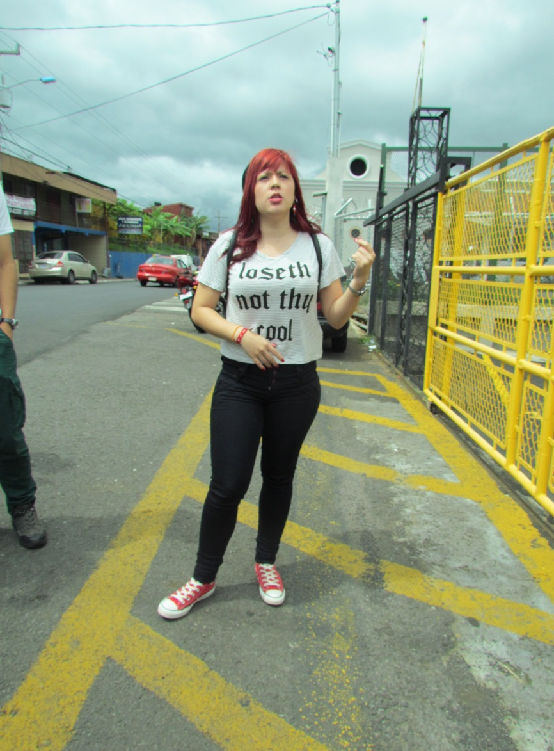
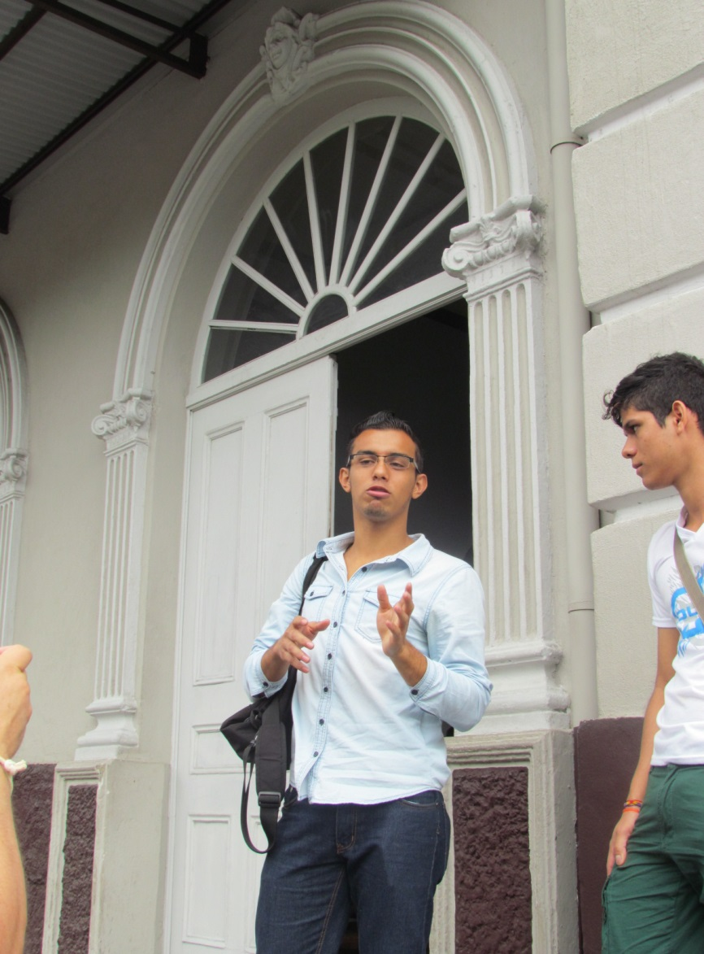
Notes:
A few college students, including Dani and Rodolfo, took us on a tour of the city of Heredia. During the tour we saw the local jail, the Municipal Hall, the “parque”, and the marketplace, or “mercado.”

Slide 4
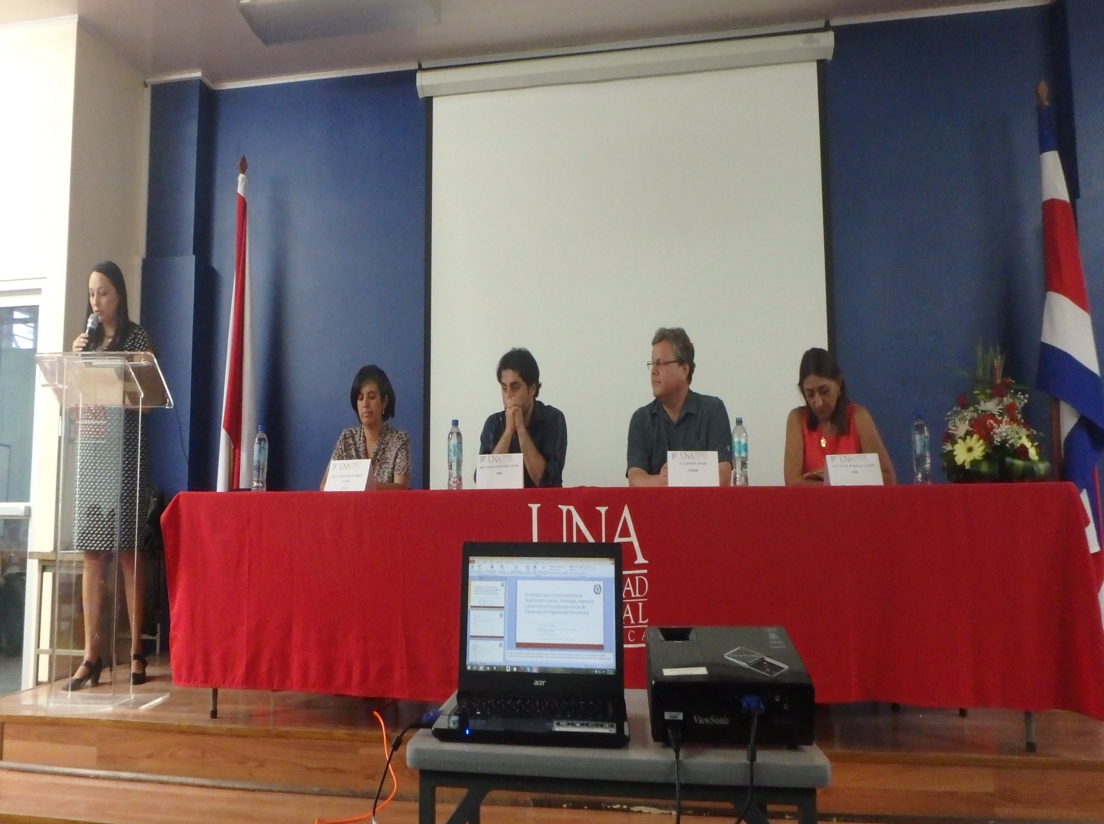
Notes:
On the first day of the symposium we sat in on a panel, which included professors of the UNA and Dr. Adams.

Slide 5
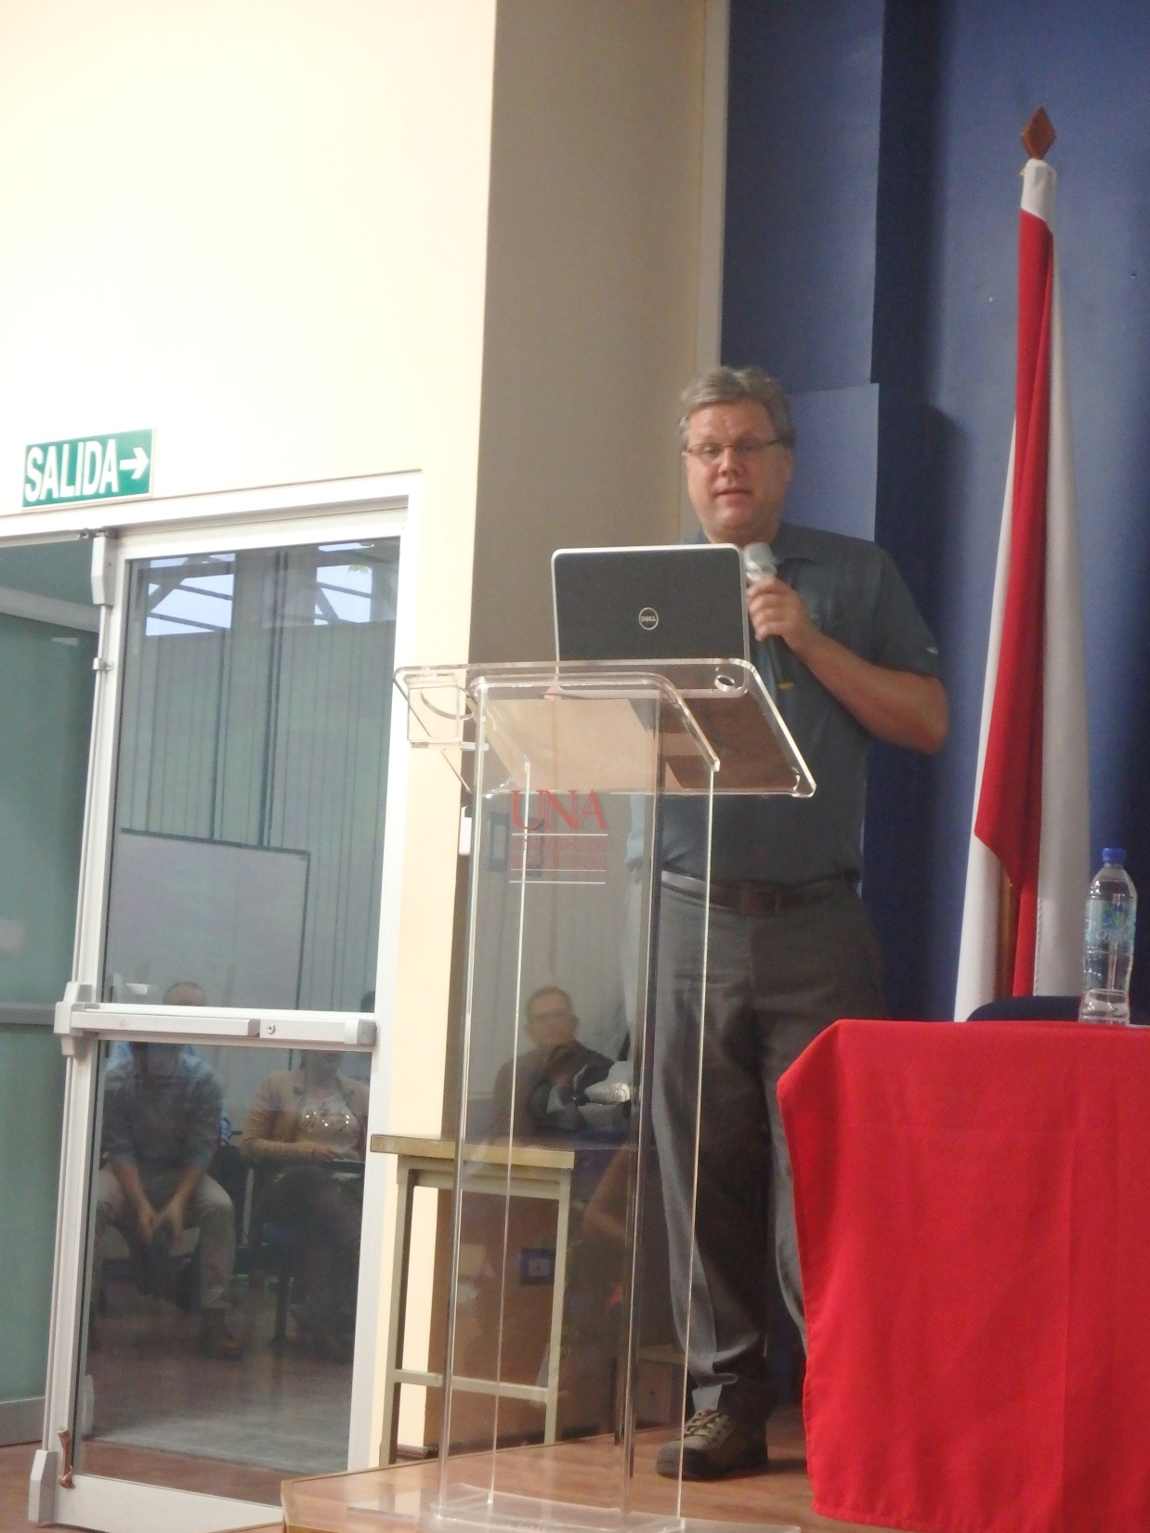
Notes:
Dr. Adams presented information about the STEM program.

Slide 6
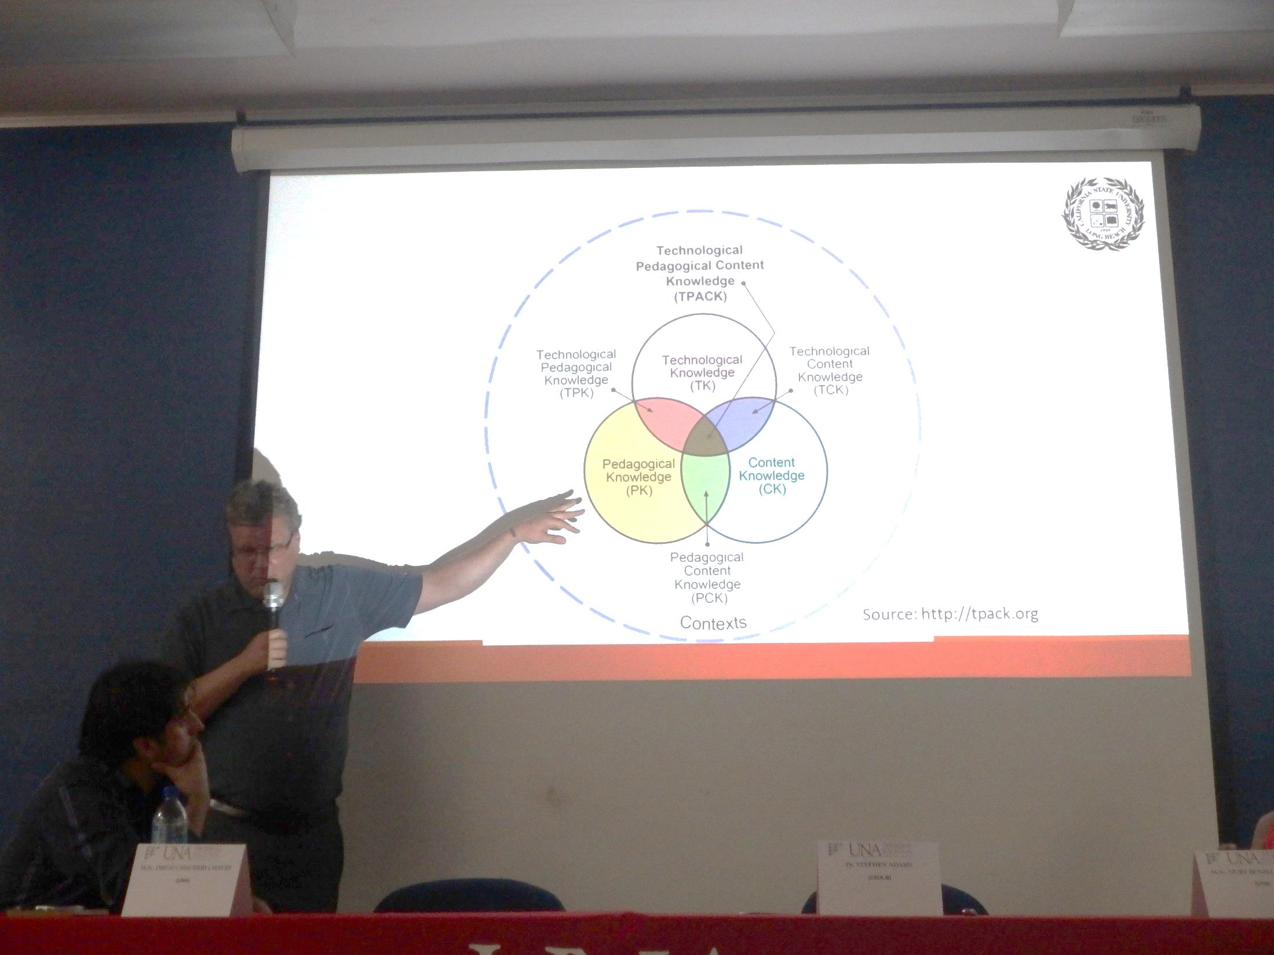

Slide 7
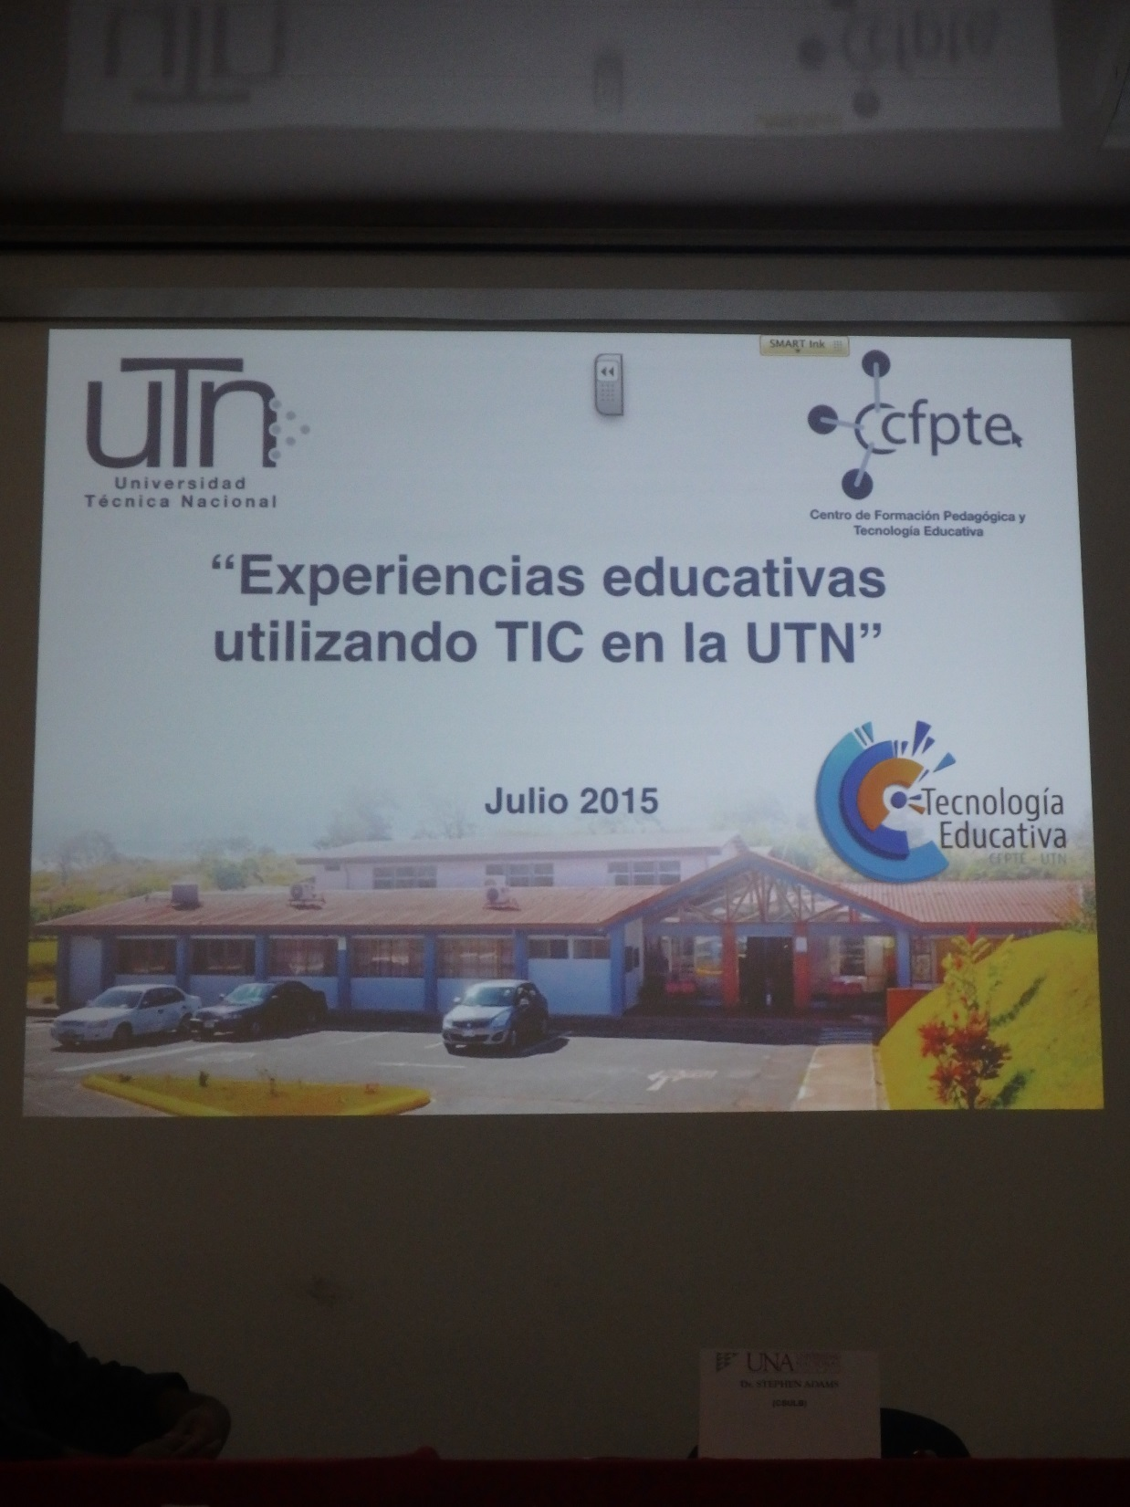
Notes:
Nury Bonilla, the director in educational technology at the Universidad Tecnica Nacional (UTC), gave an overview of the “Educational experiences using Information technology and communication at their institution.”

Slide 8
Notes:
Then we were able to listen to Level 2 students in the Masters of Education program at the UNA present their project posters. I heard many great ideas, such as an English Grammar class online…

Slide 9
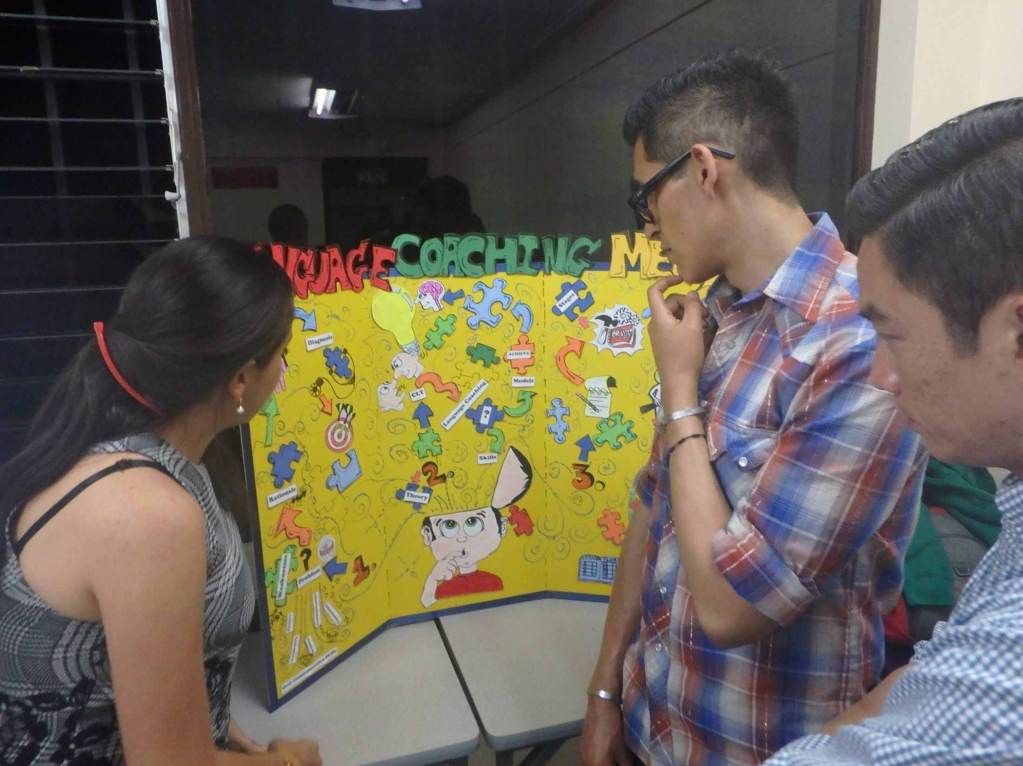
Notes:
A language coaching program using a variety of online resources…

Slide 10
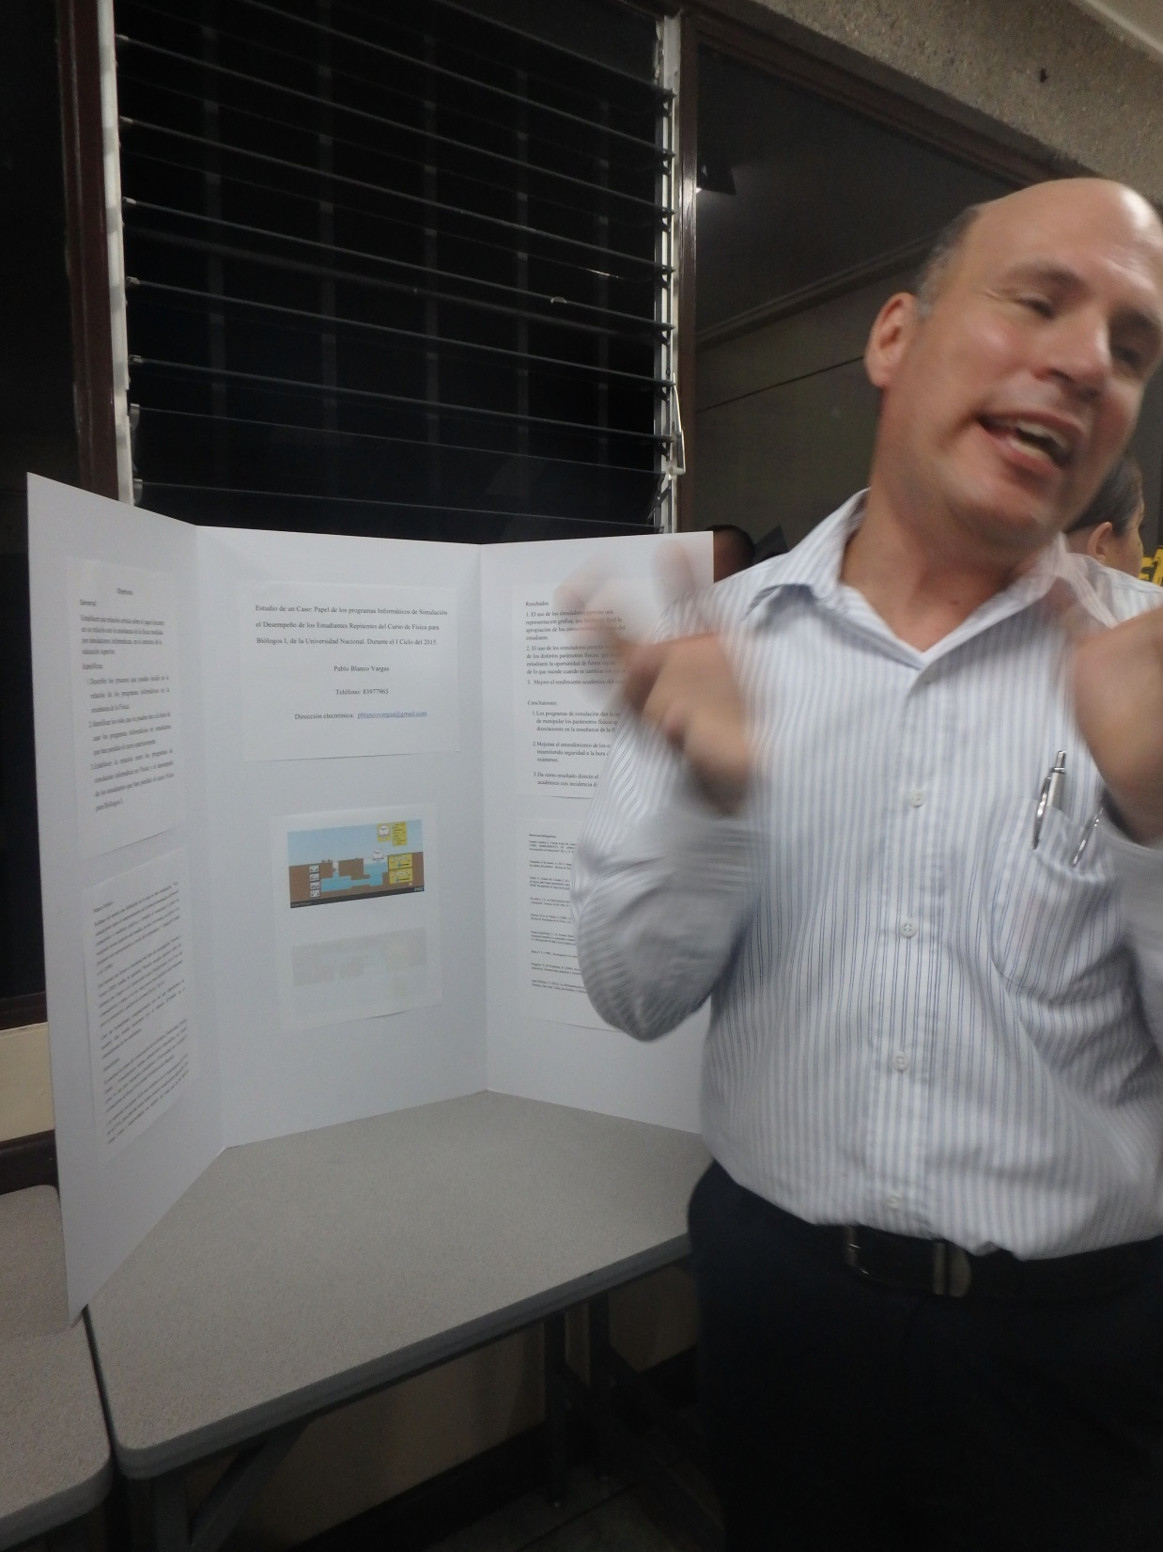
Notes:
and the use of PHET software to tutor college students in Physics.

Slide 11
Notes:
On the second day of the symposium. All of us, students of ETEC 525, did our presentation in front of a group of about 15-20 UNA students. Mimi and I were the first ones to present!

Slide 12
Notes:
We had a great discussion about Online Social Networking.

Slide 13
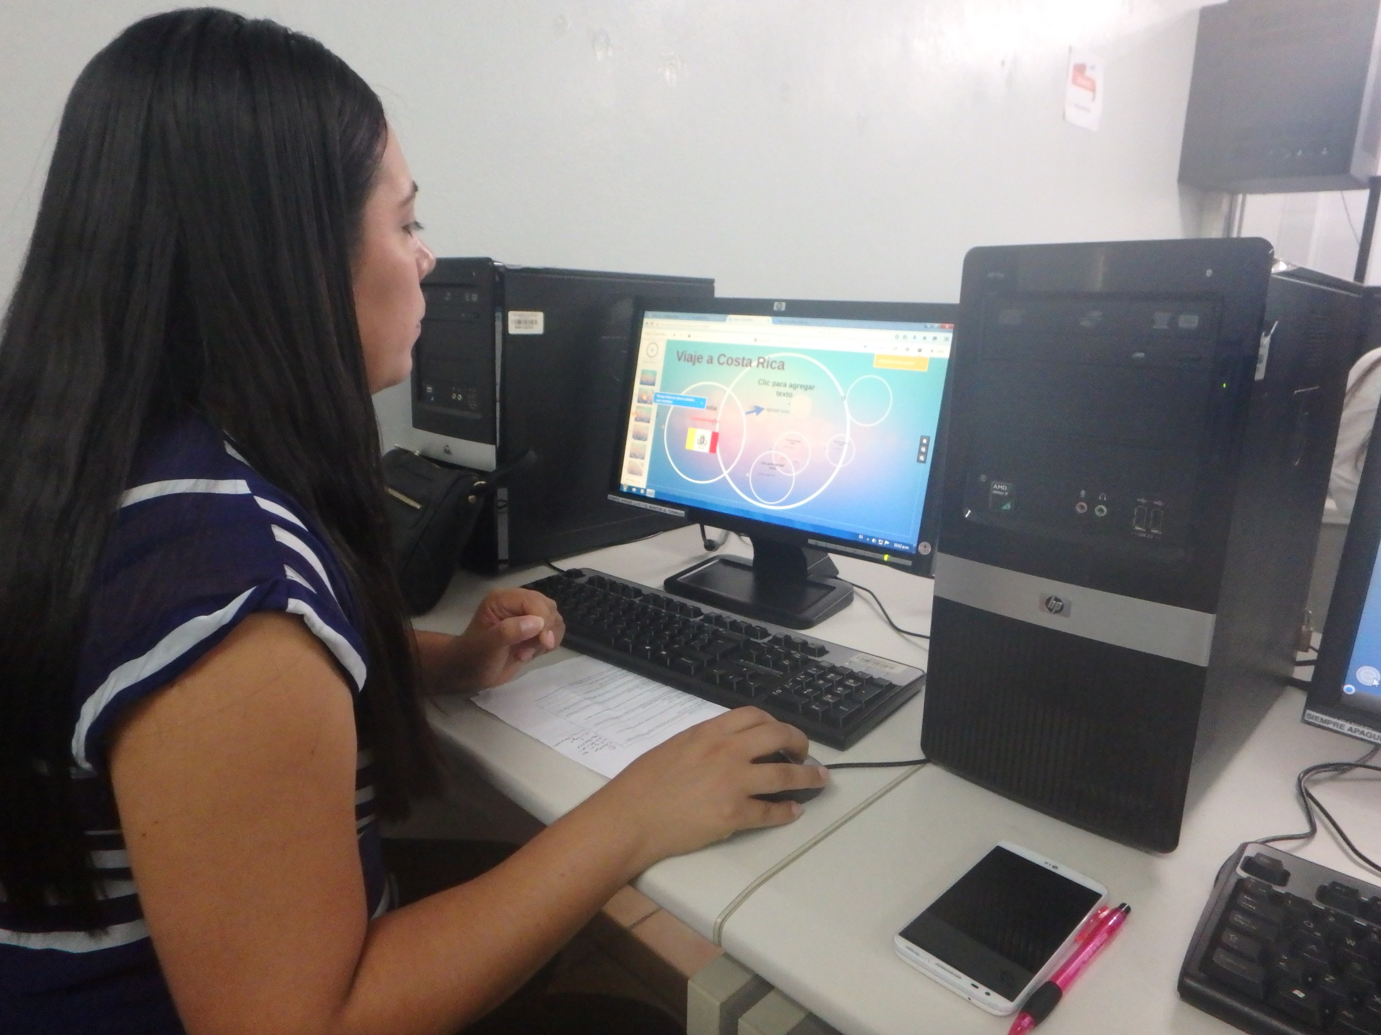
Notes:
We also had the opportunity to attend at least one workshop from a variety that were being offered. I attended the workshop that described how to use Prezi, which is a type of presentation software.

Slide 14
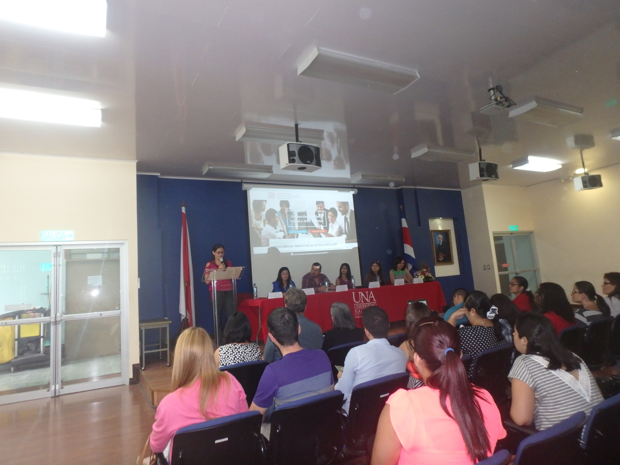
Notes:
To end the symposium, we listened to a panel that described a bimodal and virtual evaluation process that is being implemented at the university, which was followed by Q&A.

Slide 15
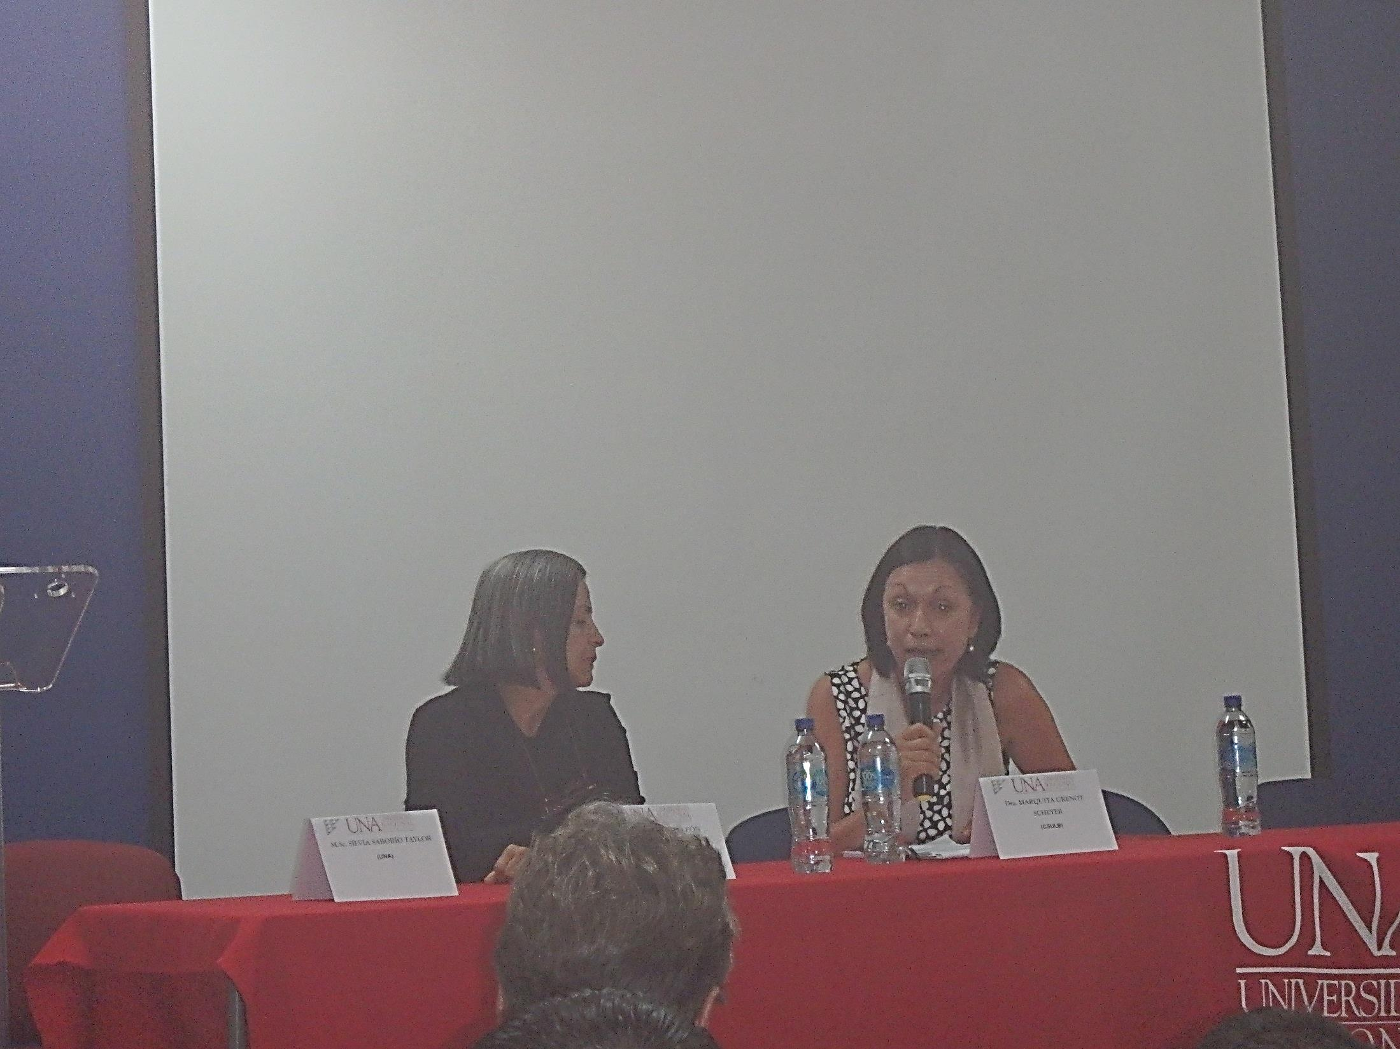
Notes:
This year, our group was very lucky to have the presence of the CSULB Dean of the College of Education, Dr. Marquita Grenot-Scheyer

Slide 16
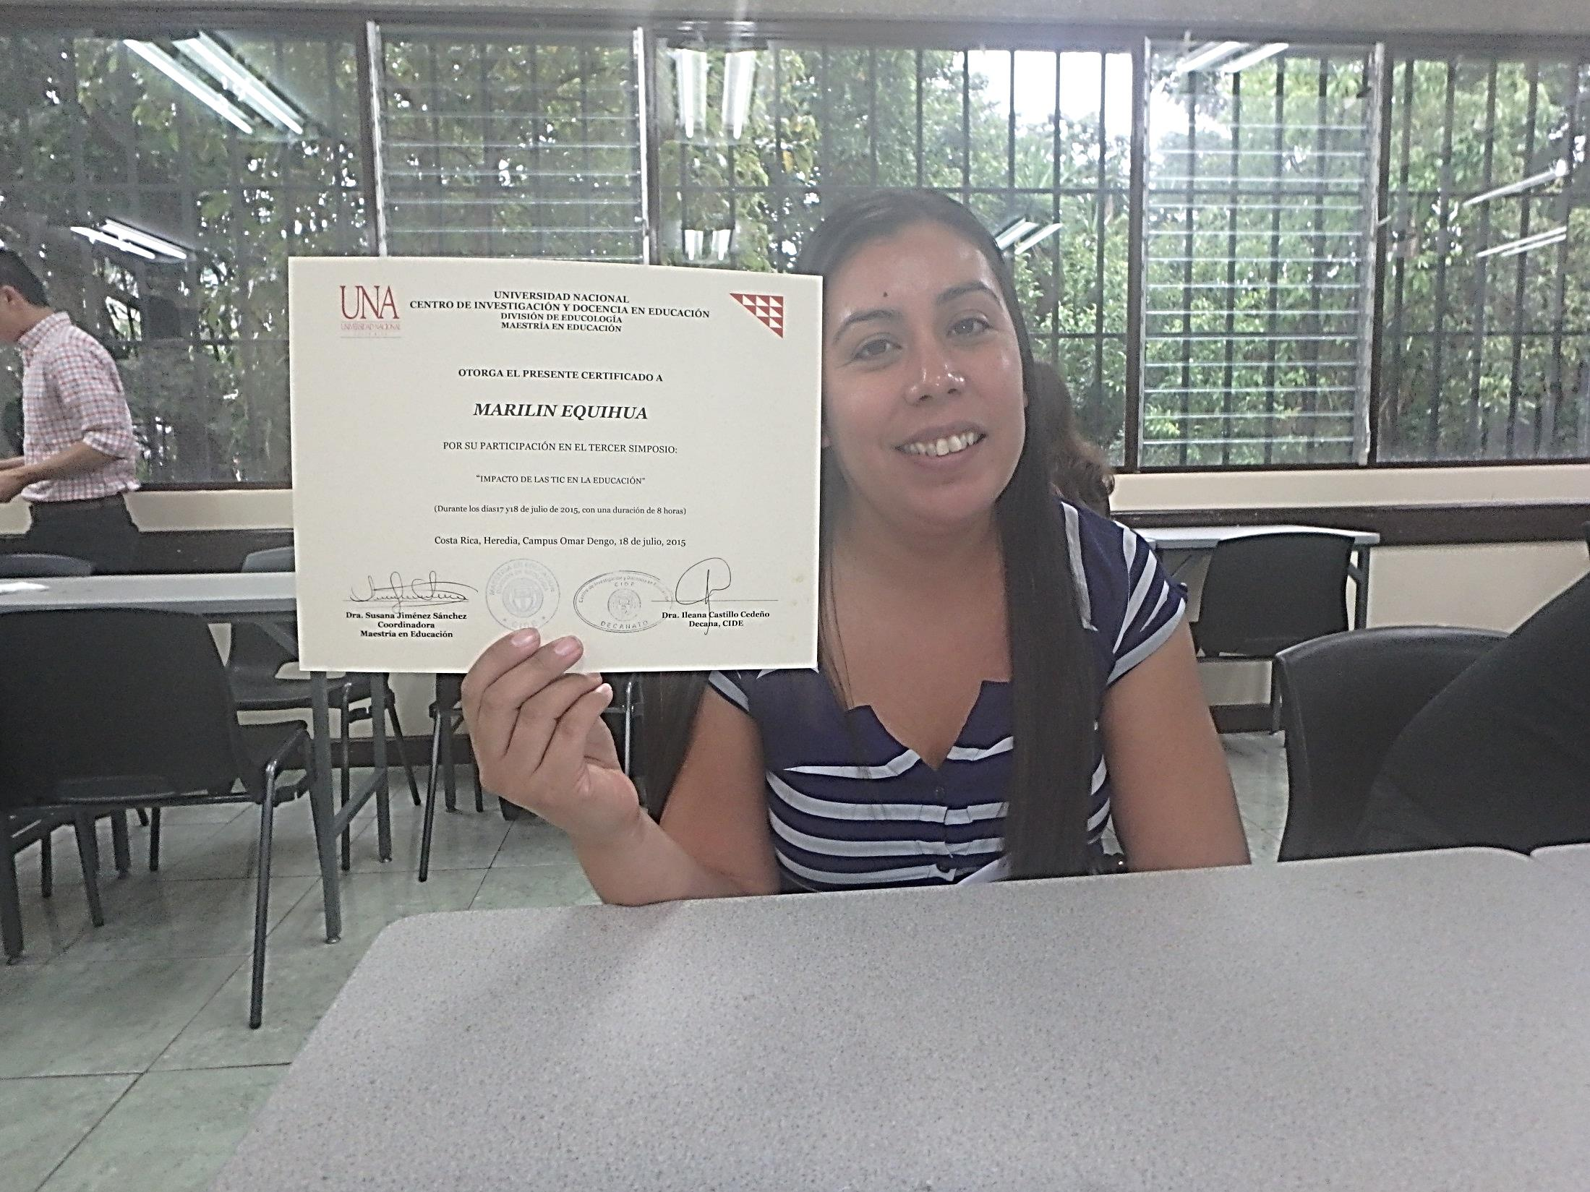
Notes:
At the conclusion of the symposium, we received a Certificate of Completion from the UNA.

Slide 17
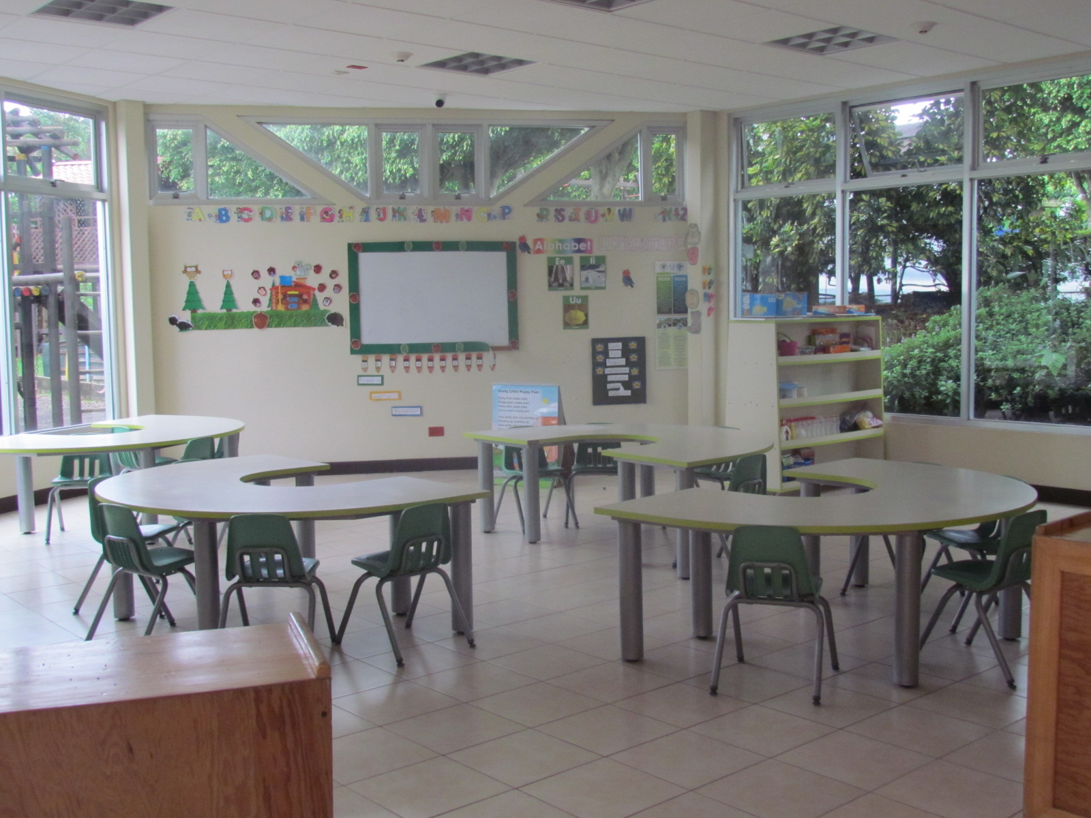
Notes:
I had the opportunity to visit the Integral Institute of Child Psychology and Isaac Martin College for 2 days.

Slide 18
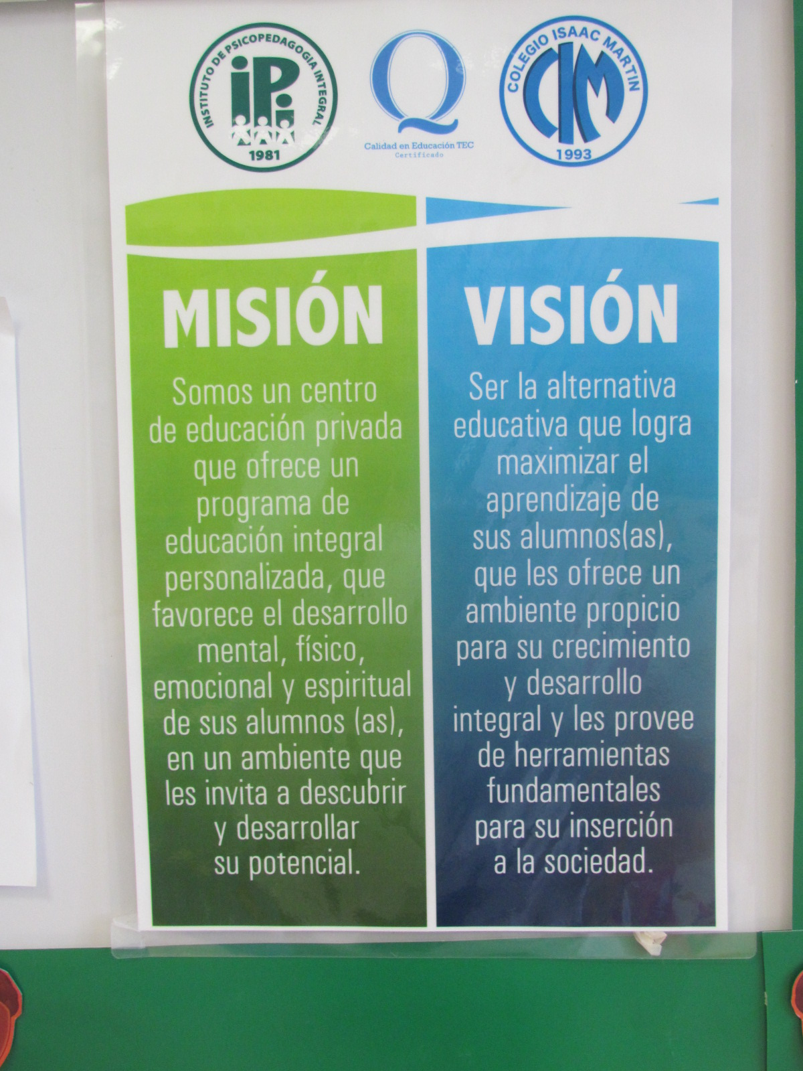
Notes:
The institute has a mission and vision statement, similar to many elementary schools here in California.

Slide 19
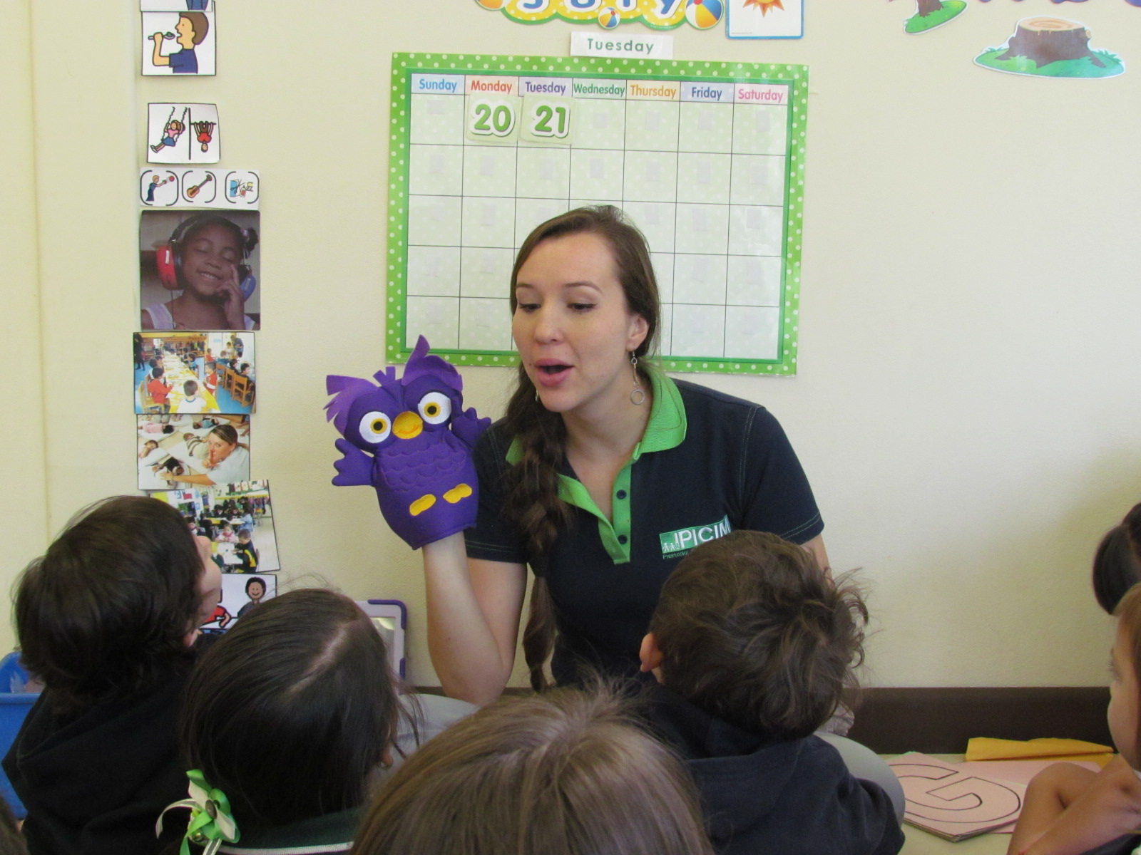
Notes:
Preschool teacher, Indira Marin, uses both English and Spanish to teach students using characters such as “Ollie the Owl.”

Slide 20
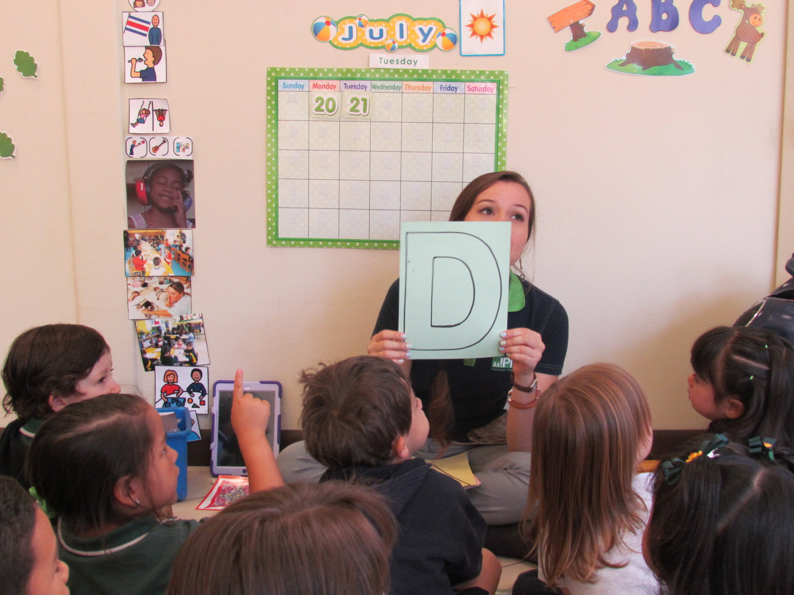
Notes:
Student ages 2 ½ to 3 ½ years old are learning to speak English.

Slide 21
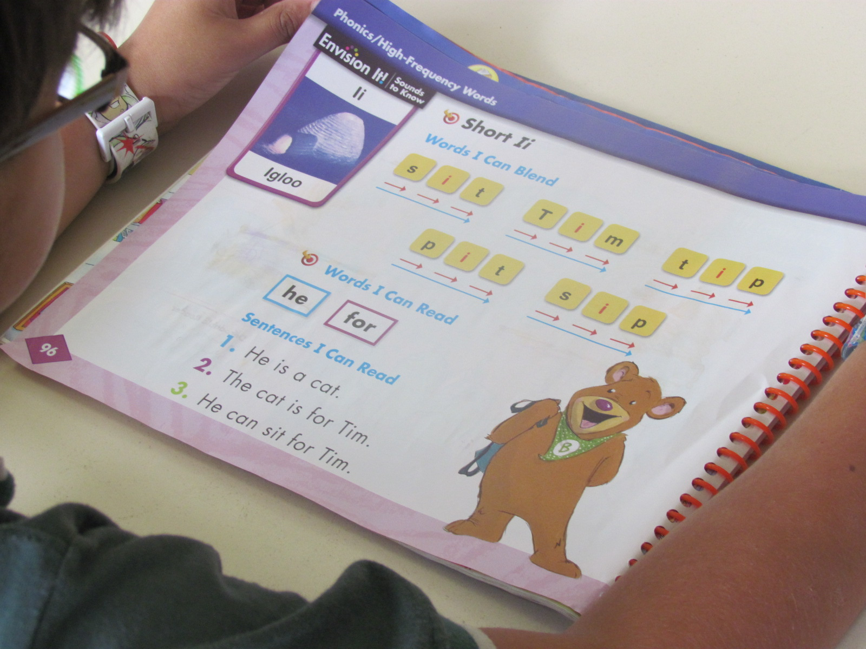
Notes:
Students age 5 are learning phonics in English using a program called “Learning Journeys” by Pearson.

Slide 22
Notes:
Starting in preschool teachers use technology, such as IPADS, to teach.

Slide 23
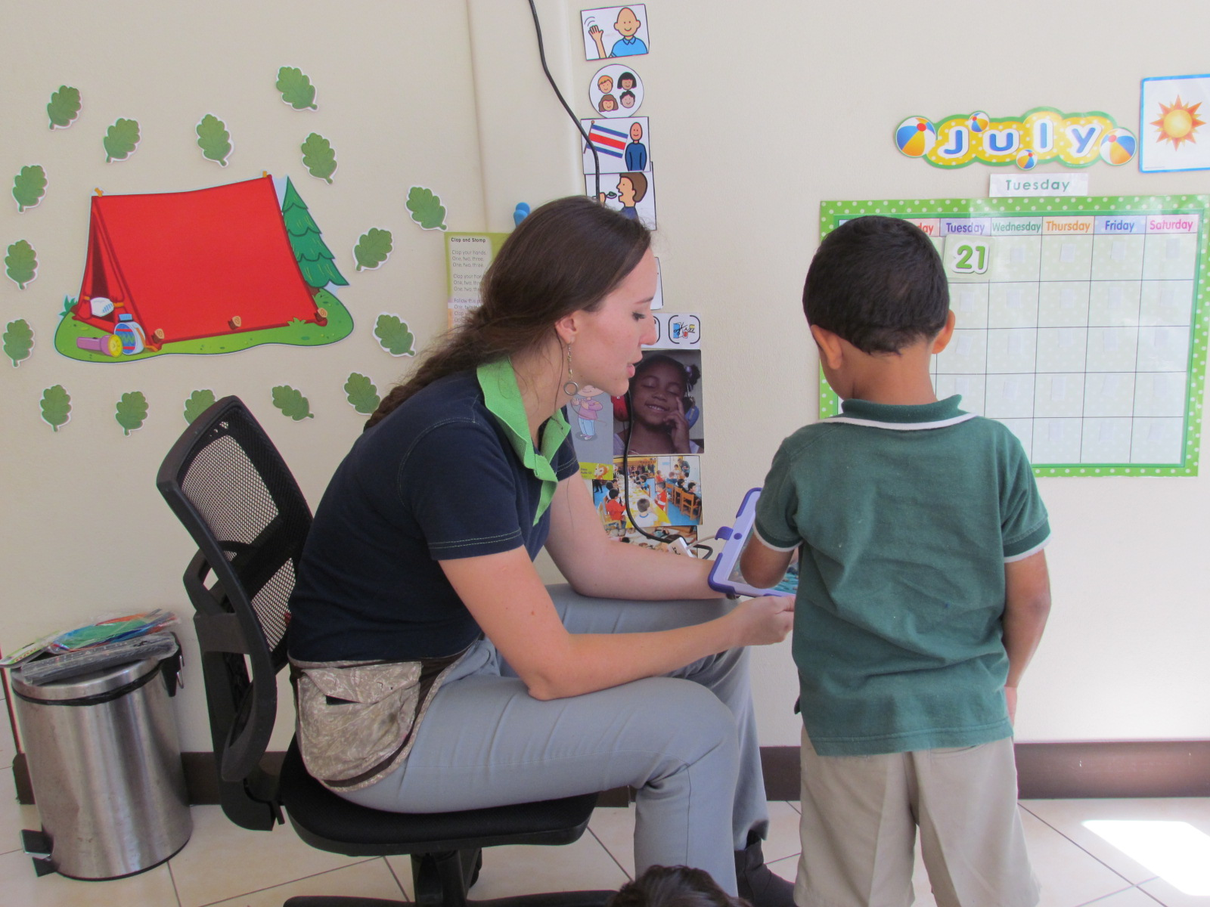
Notes:
Students are also able to use technology in the classroom.

Slide 24
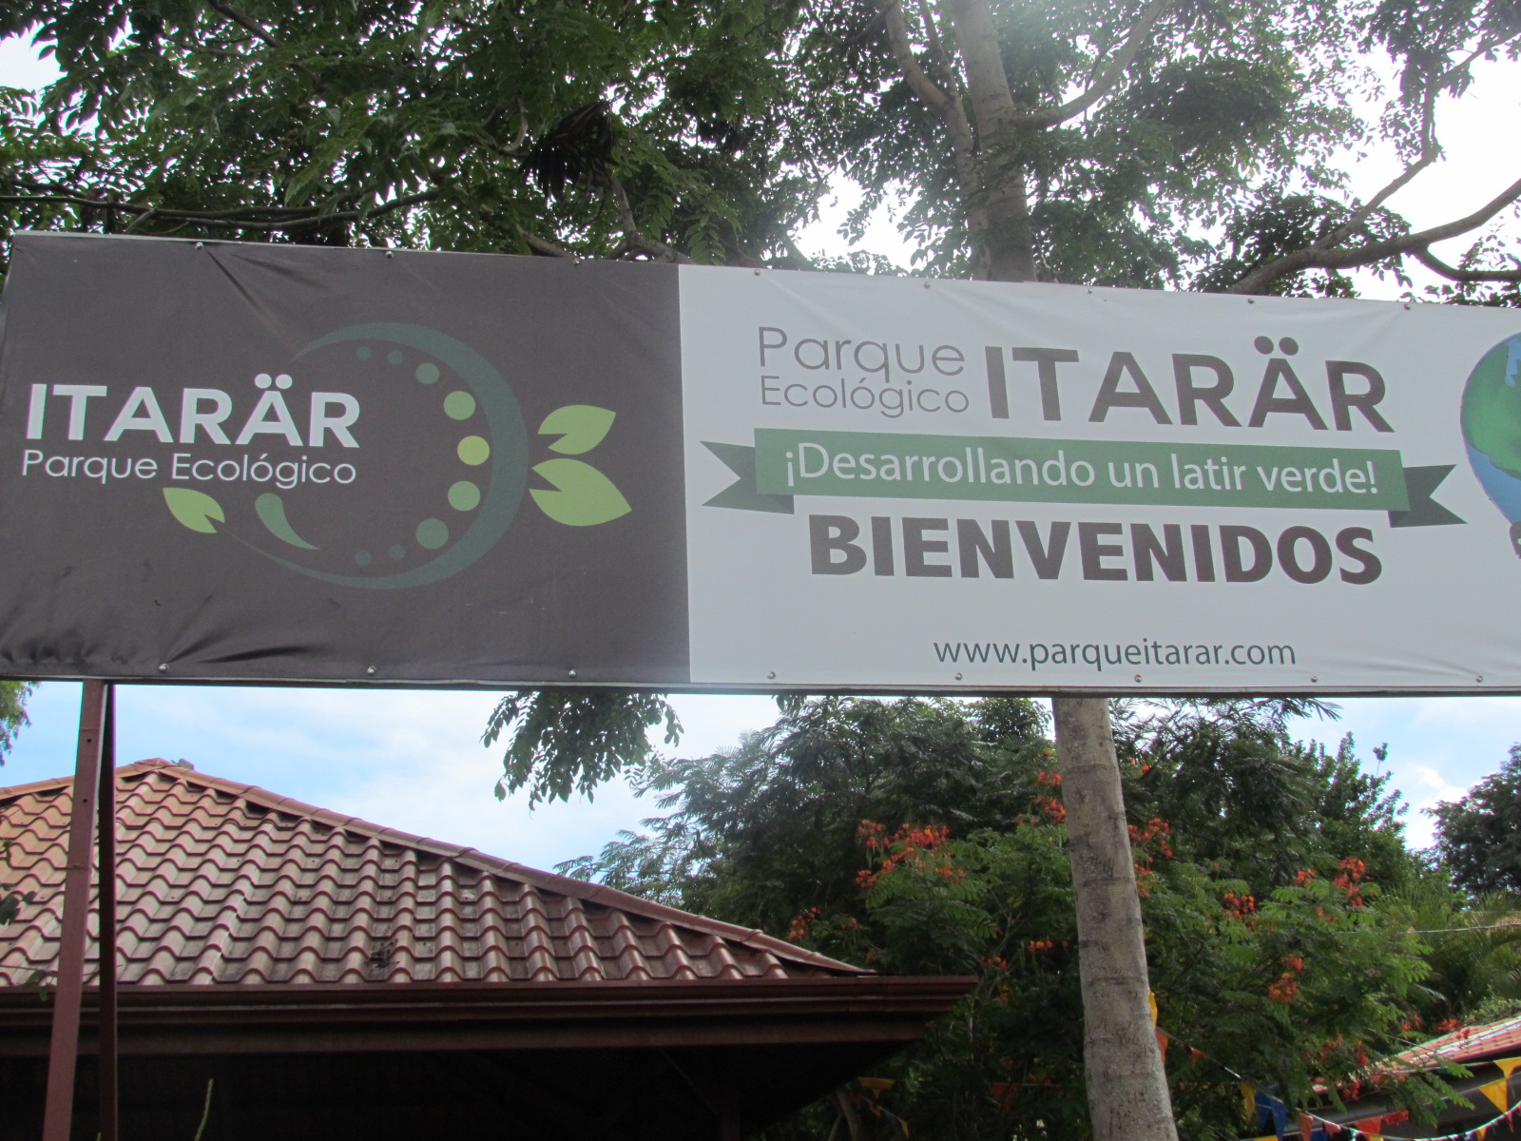
Notes:
An interesting thing about this institute is that they have an Ecological Park in their backyard.

Slide 25
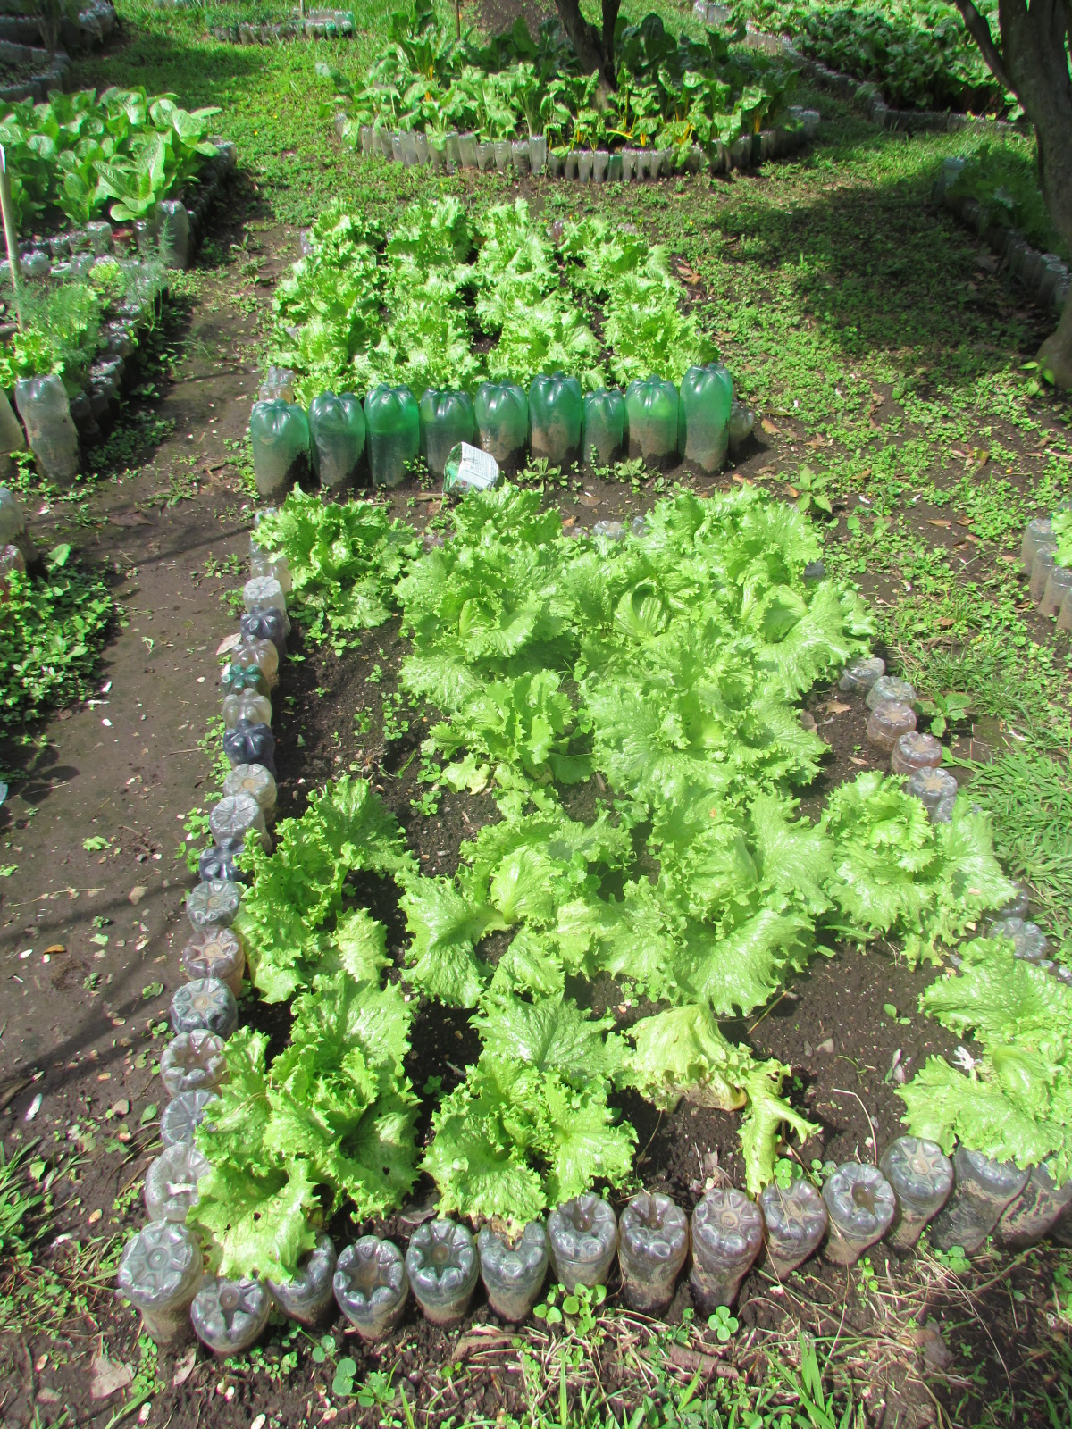
Notes:
Students plant different vegetables…

Slide 26
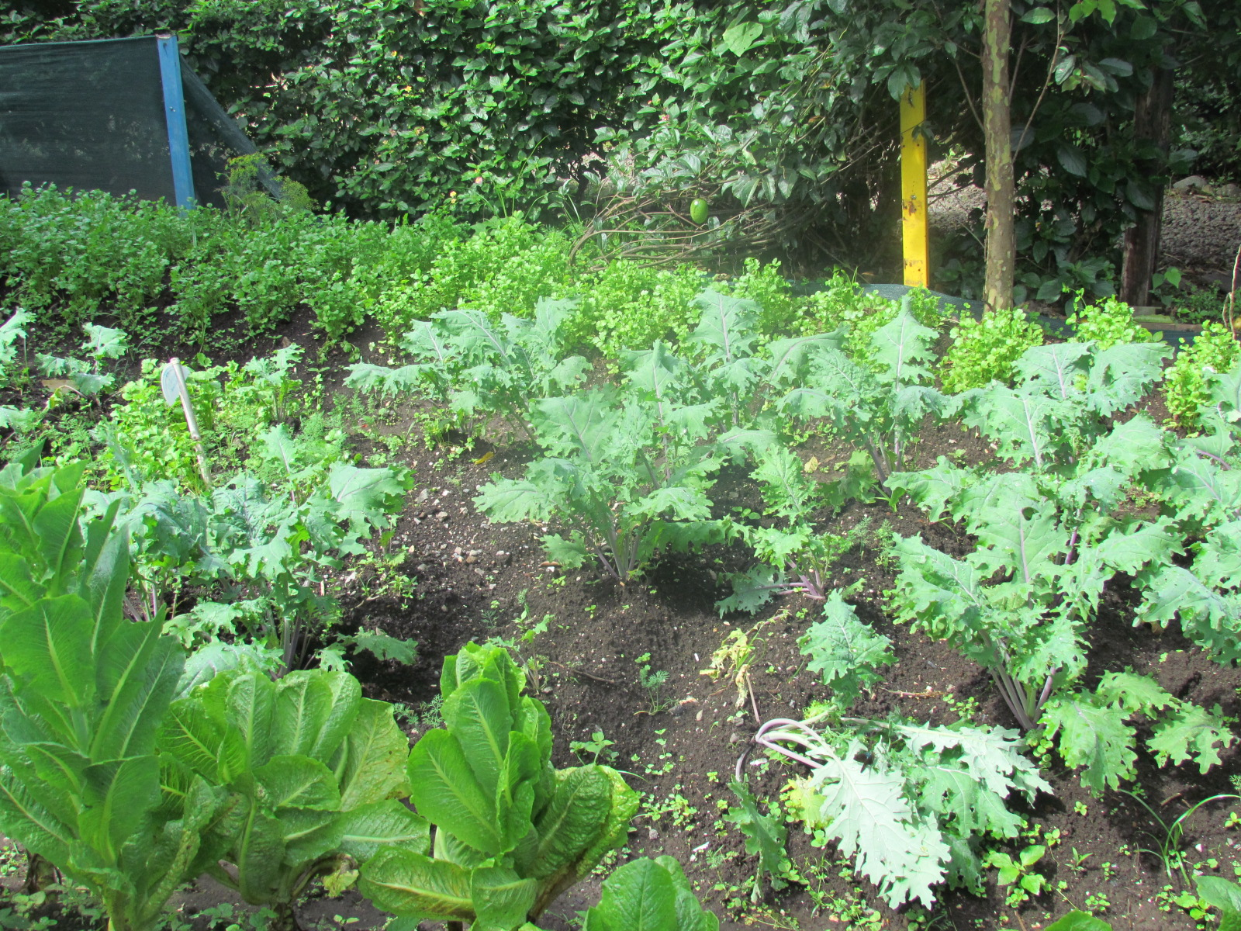
Notes:
which they are now starting to sell. The money they make go towards school expenses.

Slide 27
Food
Notes:
Costa Rica has amazing food, such as the vegetables being grown at the school and delicious fruit.

Slide 28
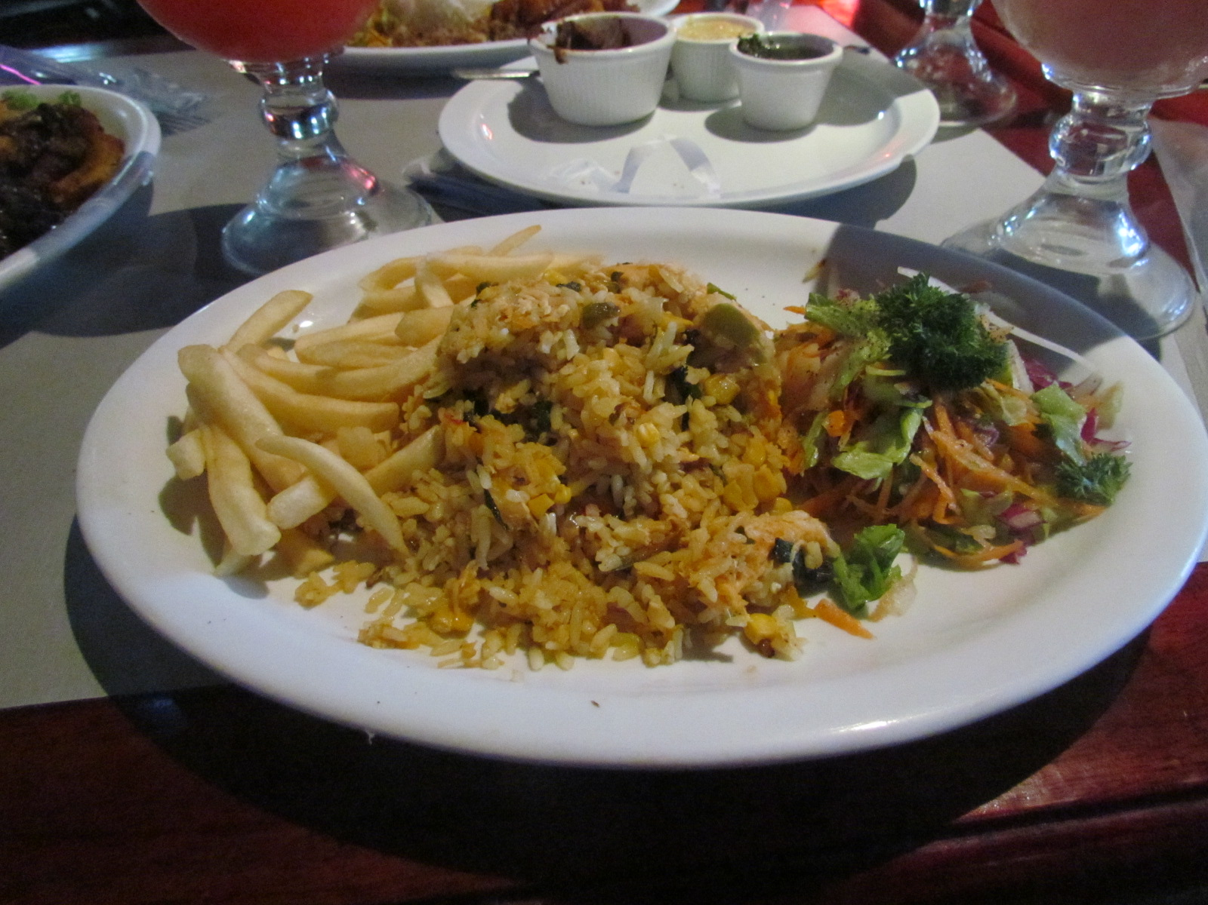
Notes:
We tried amazing food, such as arroz con pollo (chicken and rice)…

Slide 29
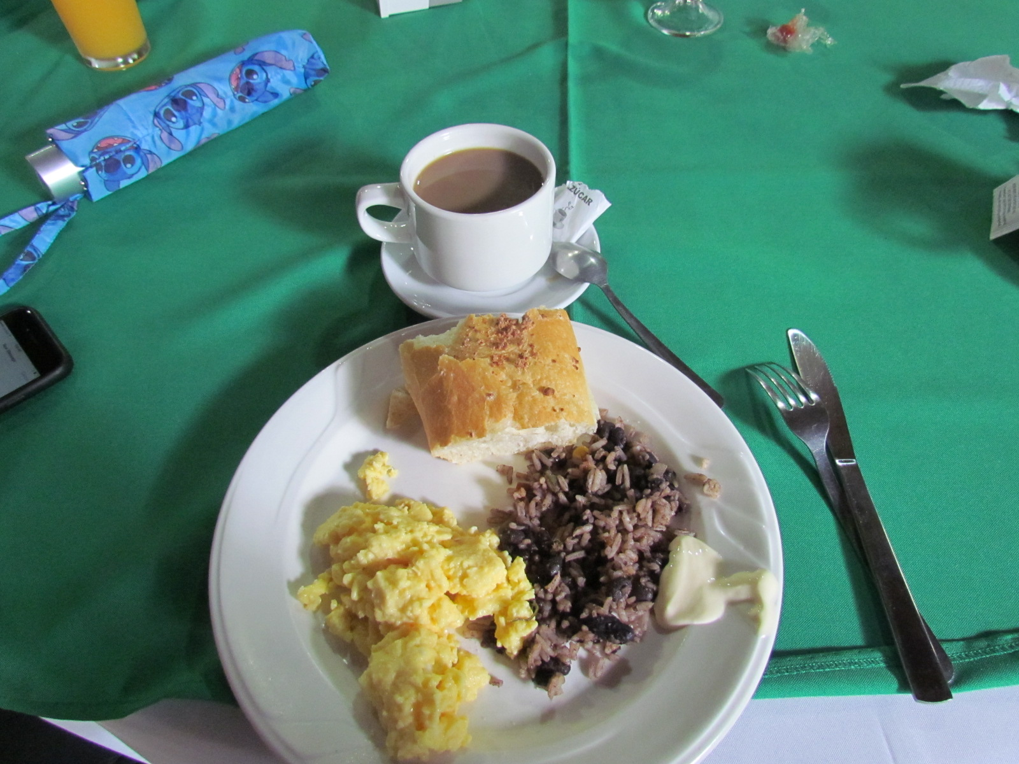
Notes:
Gallo pinto (rice and beans)…

Slide 30
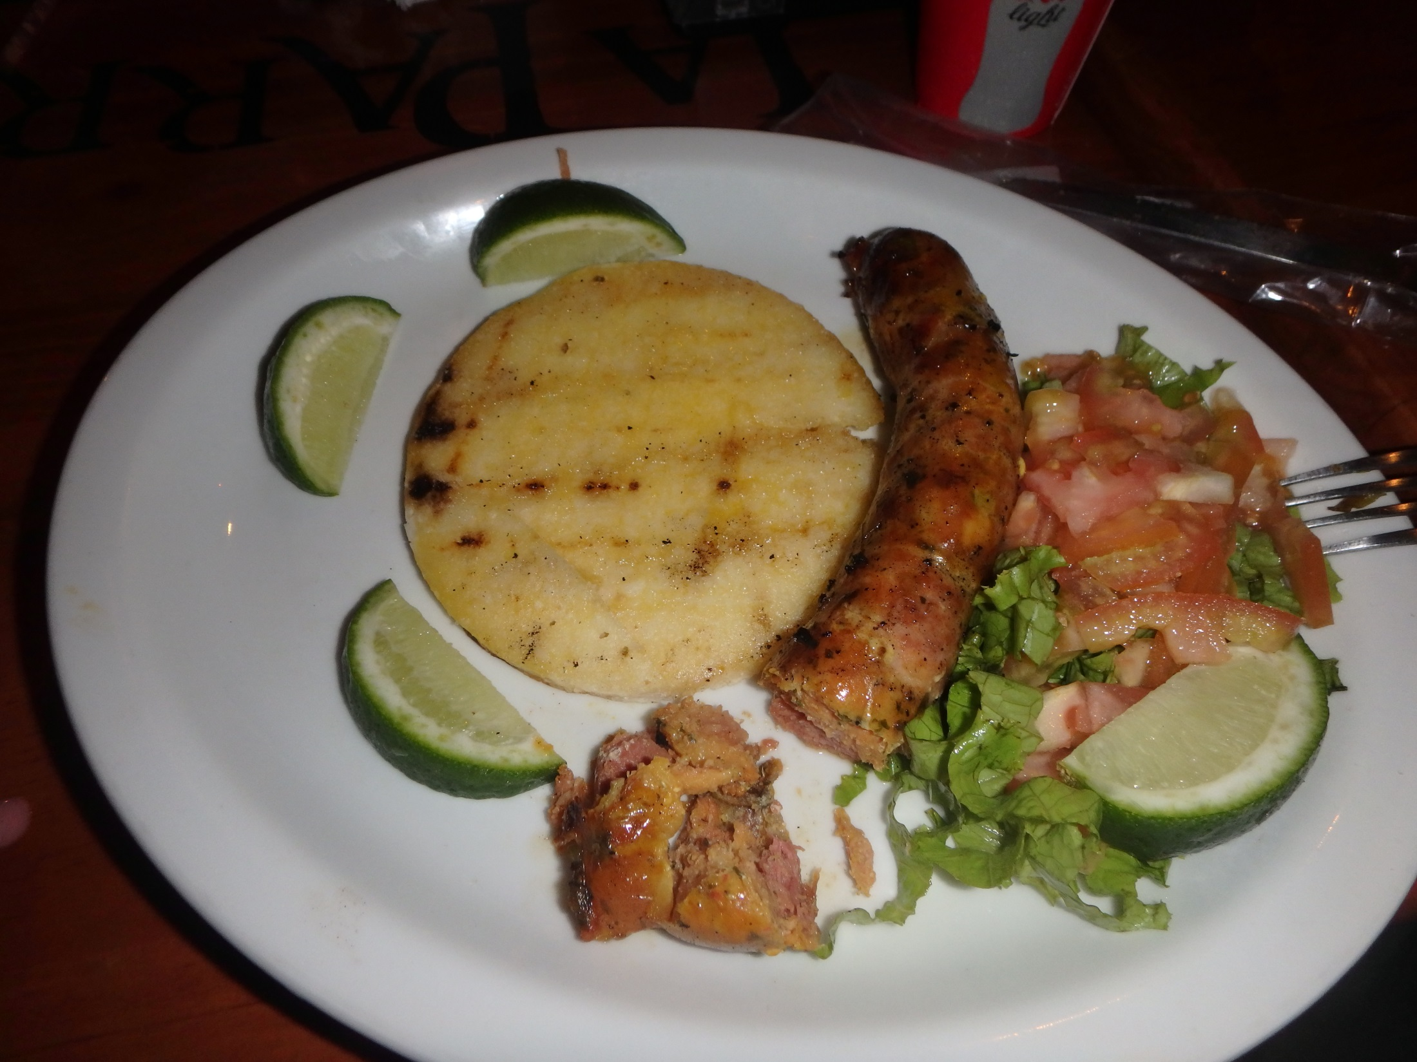
Notes:
Chorizo and arepas…

Slide 31
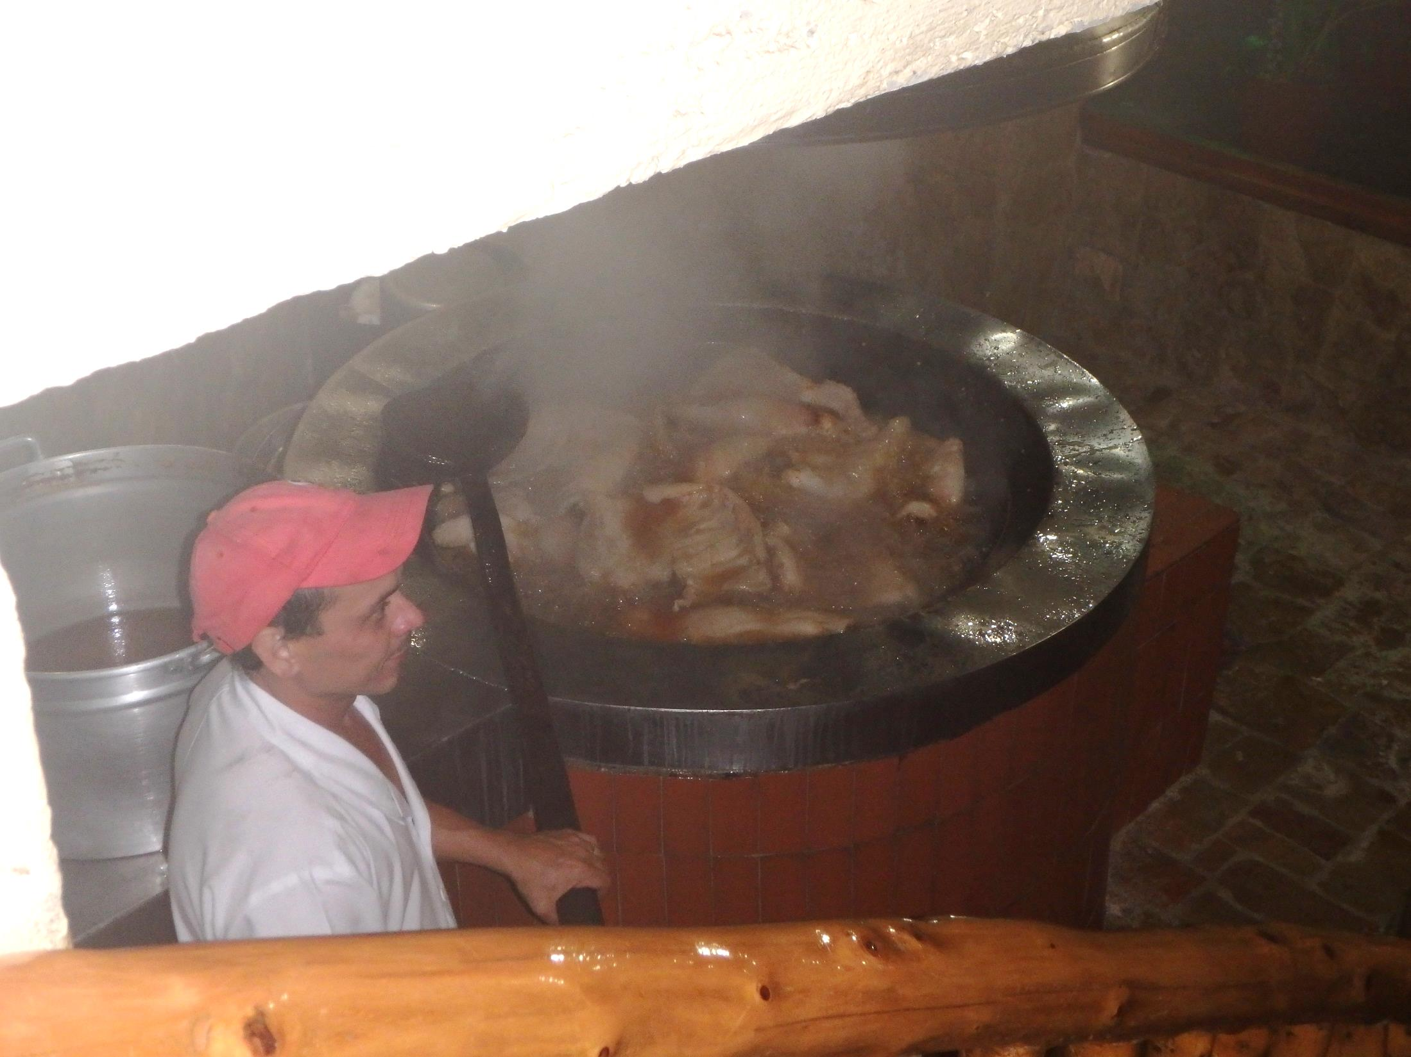
Notes:
and chicharrones.

Slide 32
Architecture
Notes:
Costa Rica also had beautiful architecture. Most of it was very old and had historical significance.

Slide 33
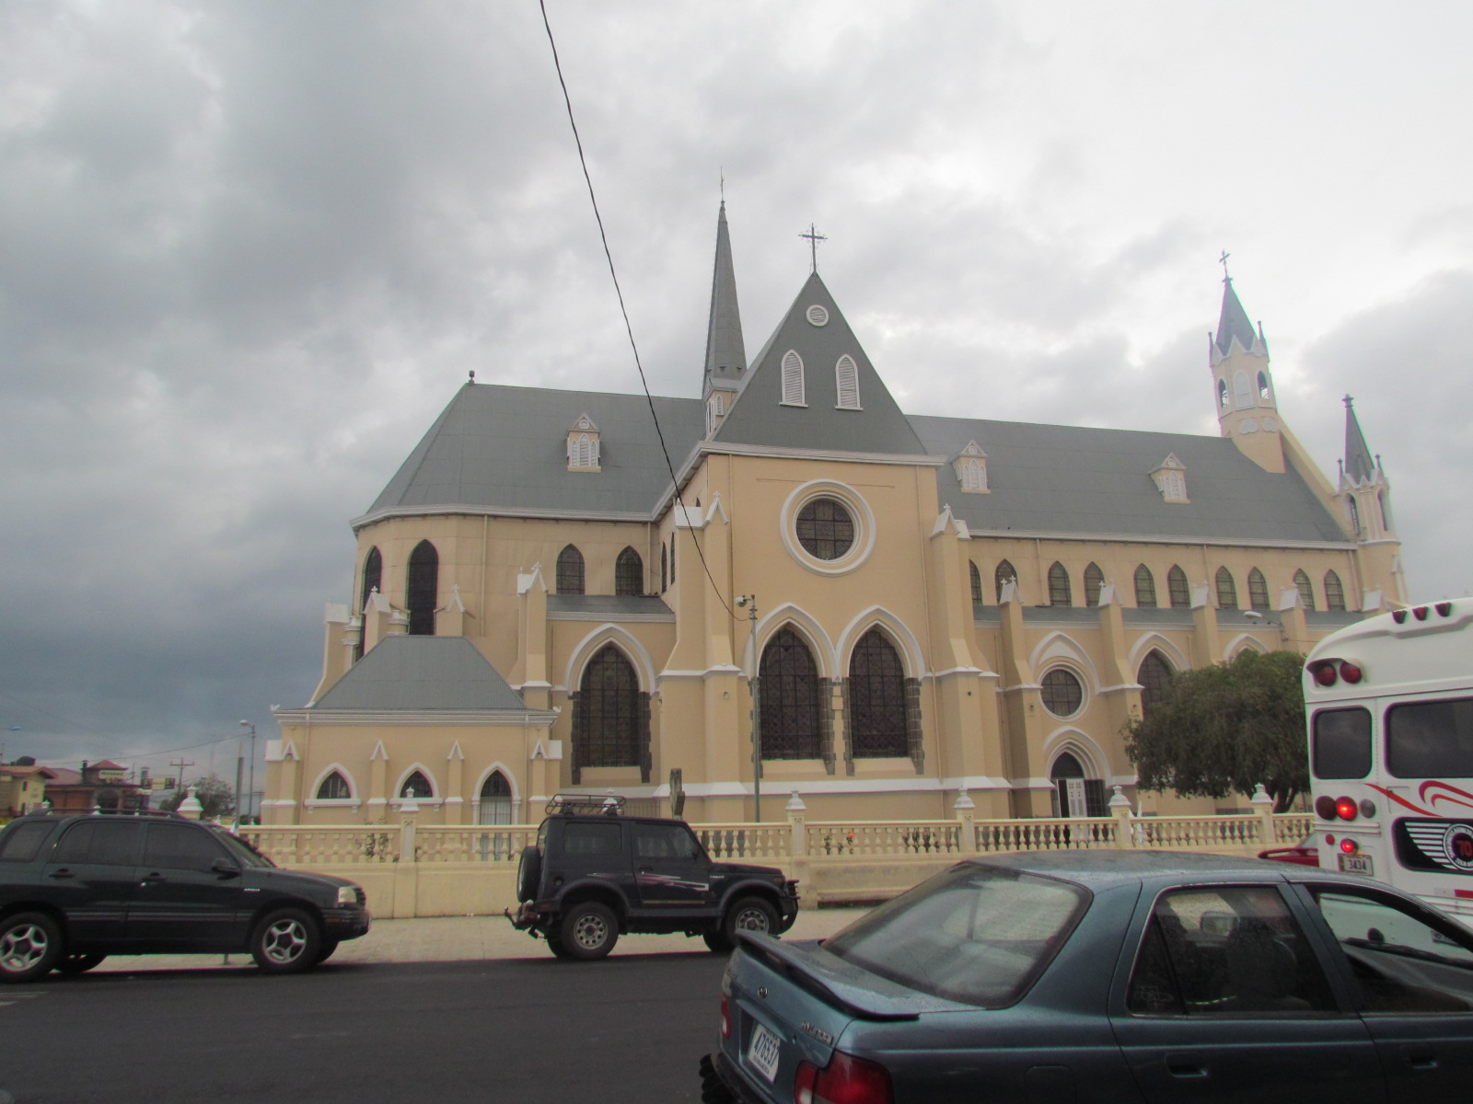
Notes:
We saw many beautiful churches.

Slide 34
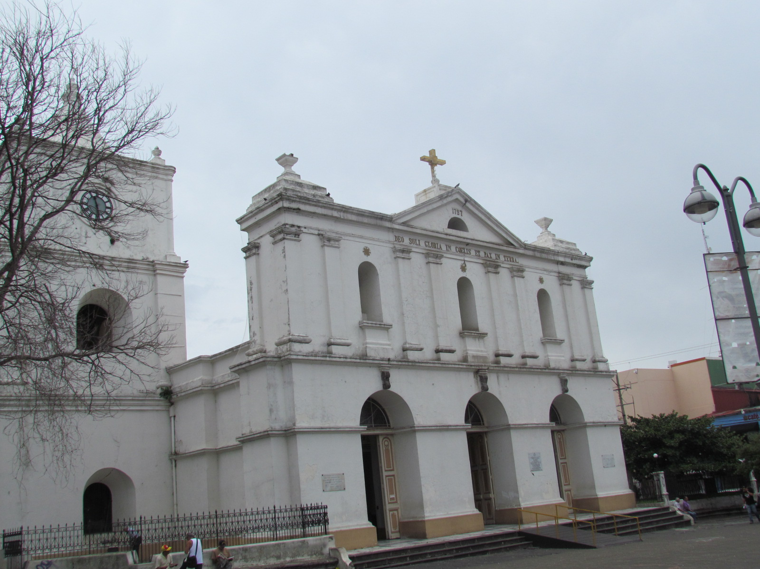

Slide 35
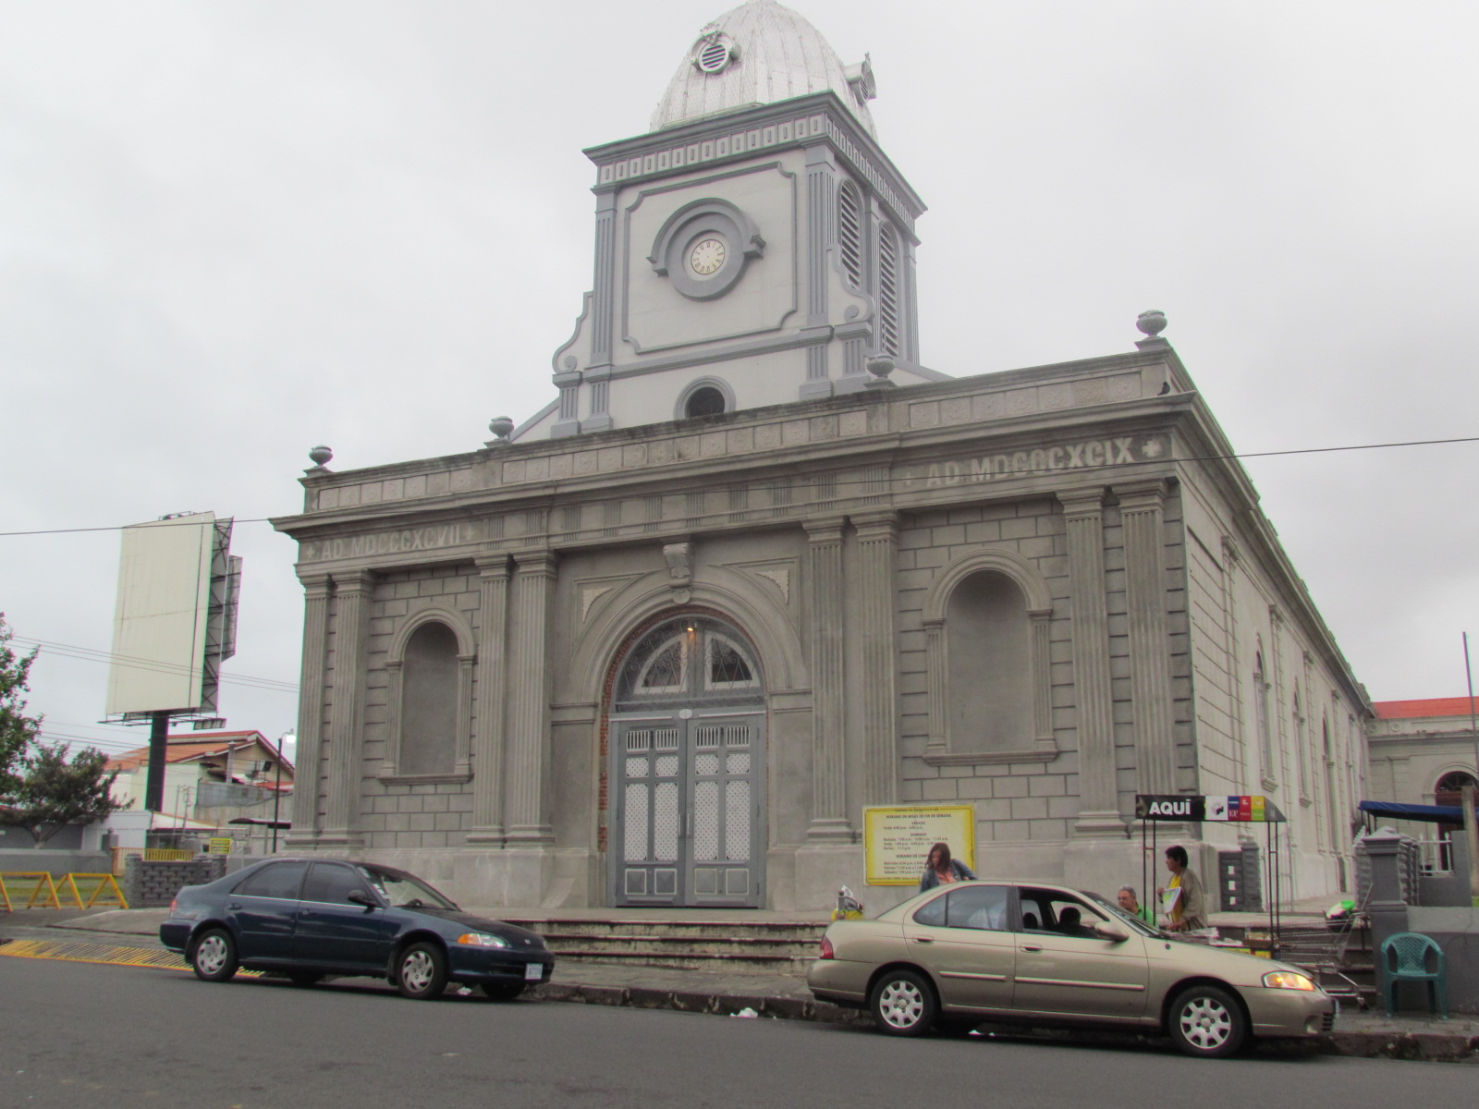

Slide 36
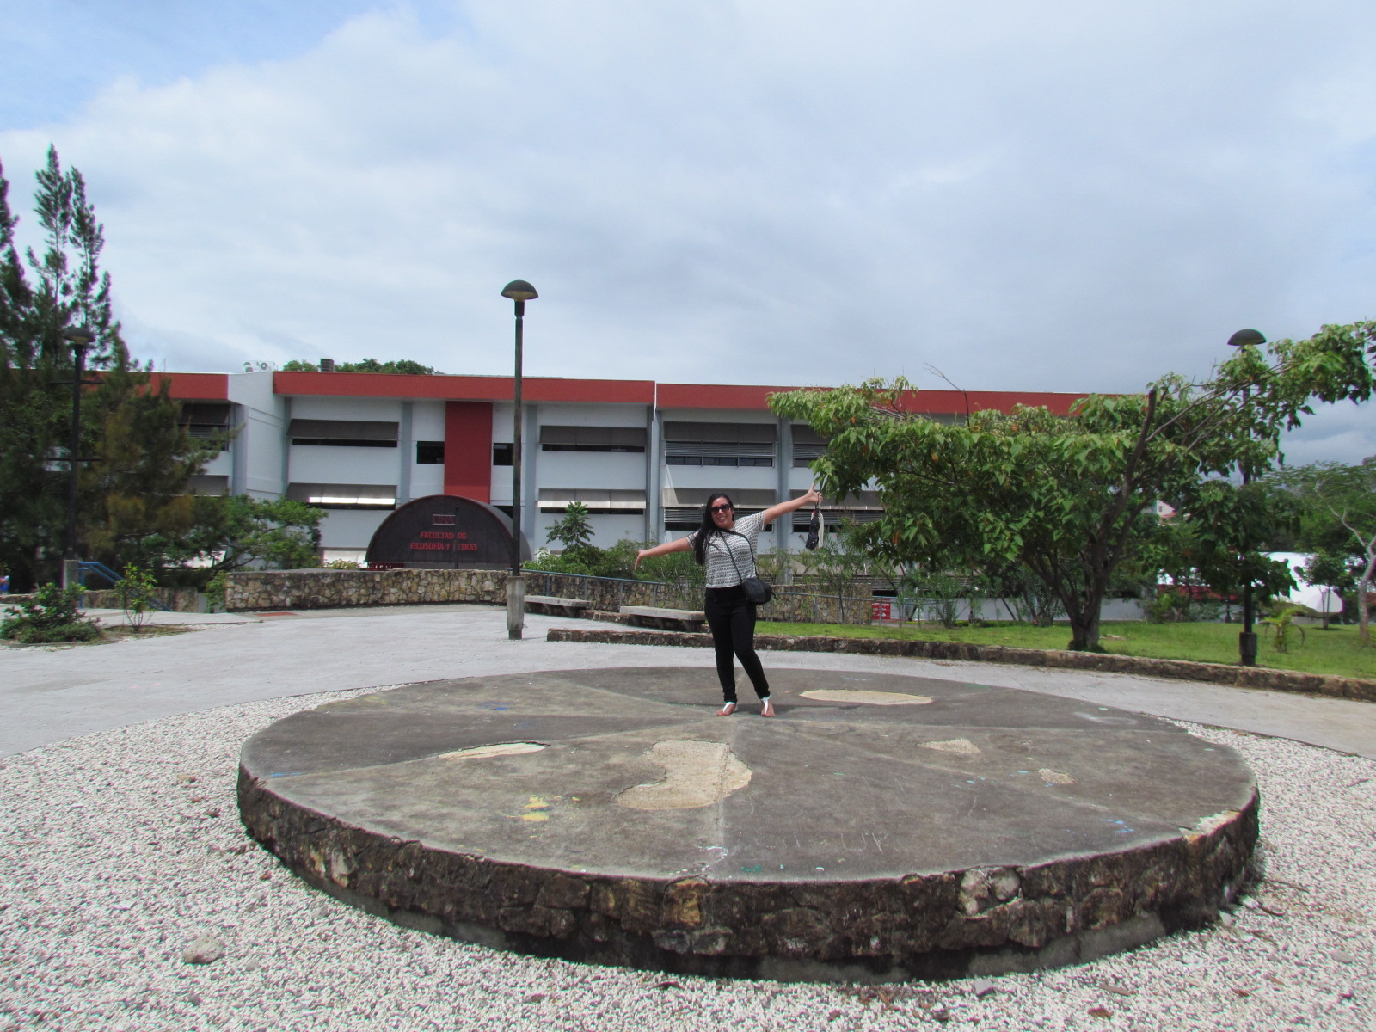
Notes:
The university also had a lot of interesting architecture.

Slide 37
Culture
Notes:
Coffee, chocolate, and sugar cane are a big part of Costa Rican culture. During our stay in Monteverde, some of us had the opportunity to take a tour of the process of making them.

Slide 38
Notes:
The tour included a coffee bean plantation that showed the different stages of making coffee.

Slide 39
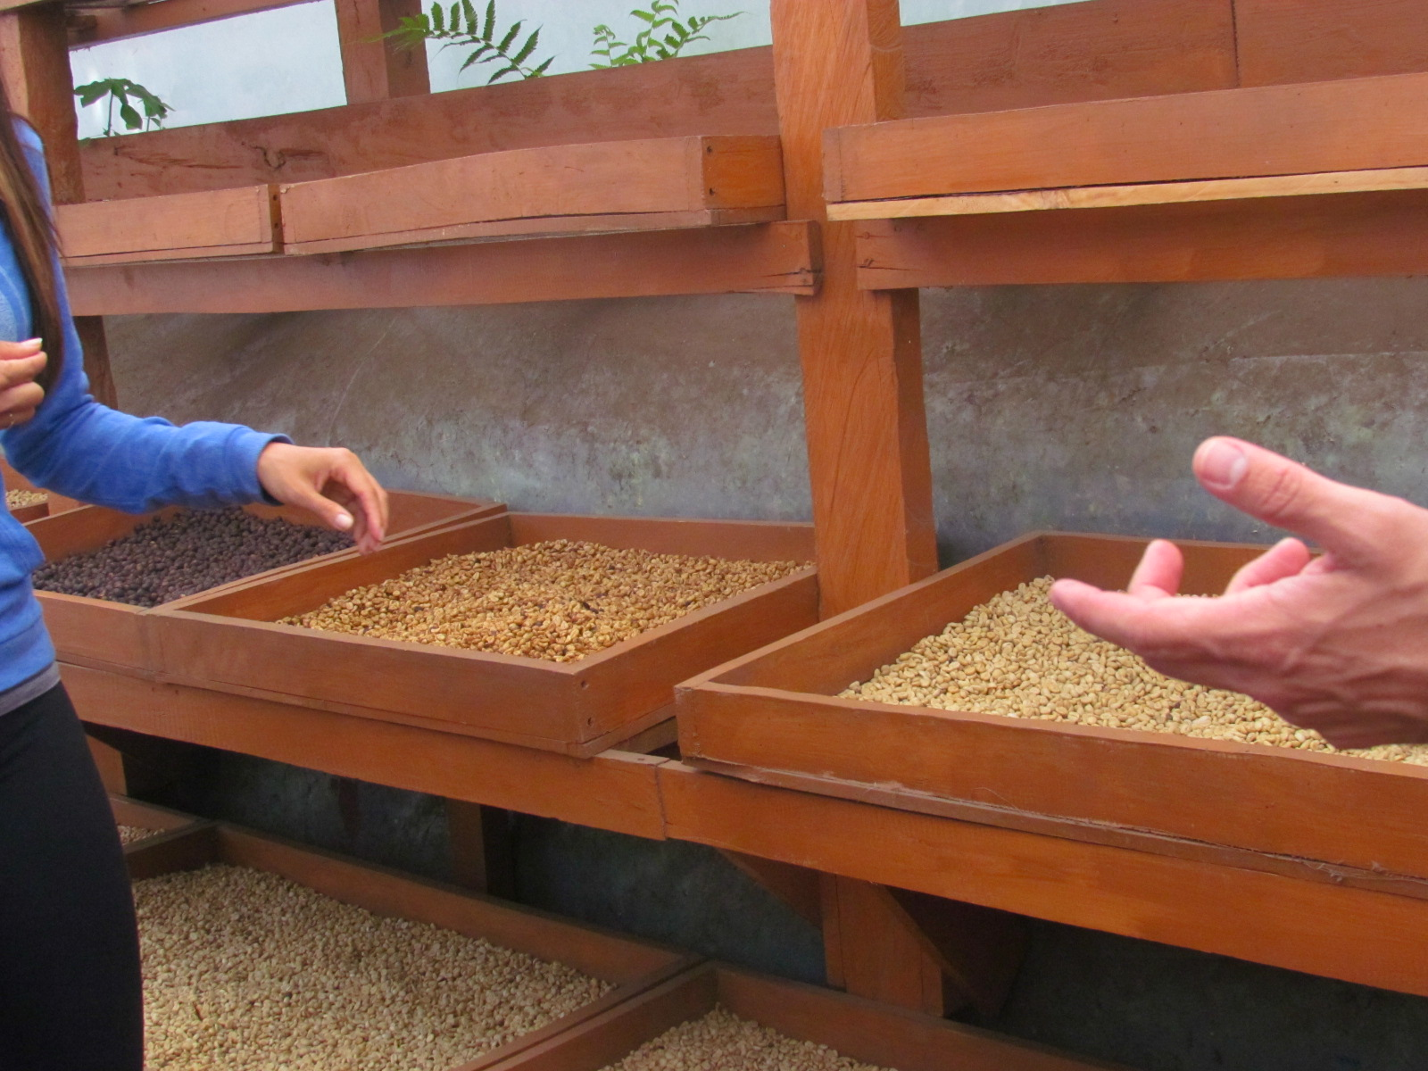

Slide 40
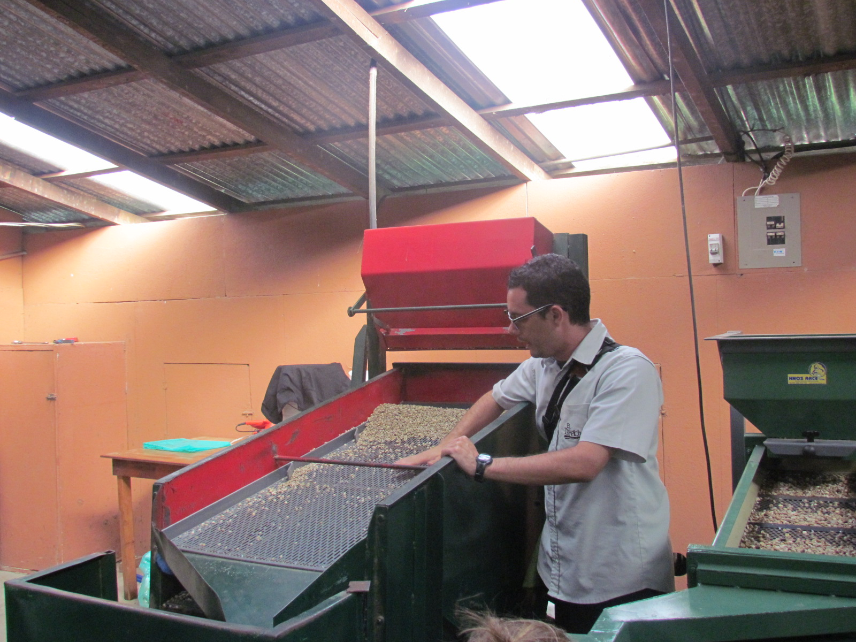

Slide 41
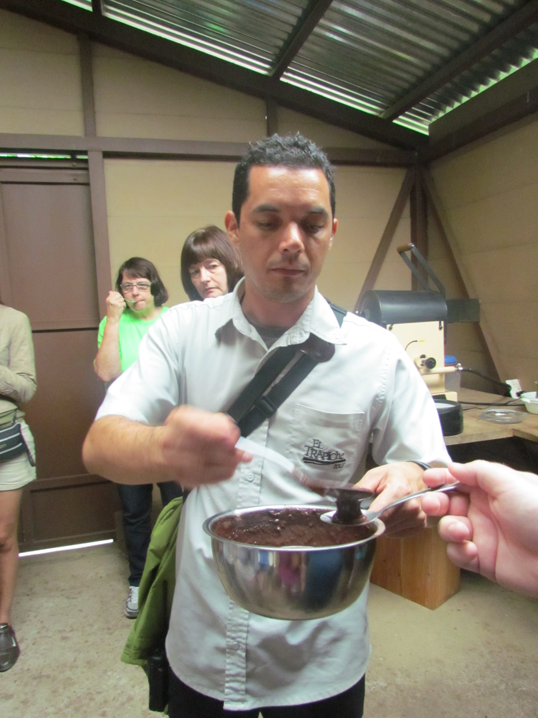
Notes:
They also explained the process used to make chocolate.

Slide 42
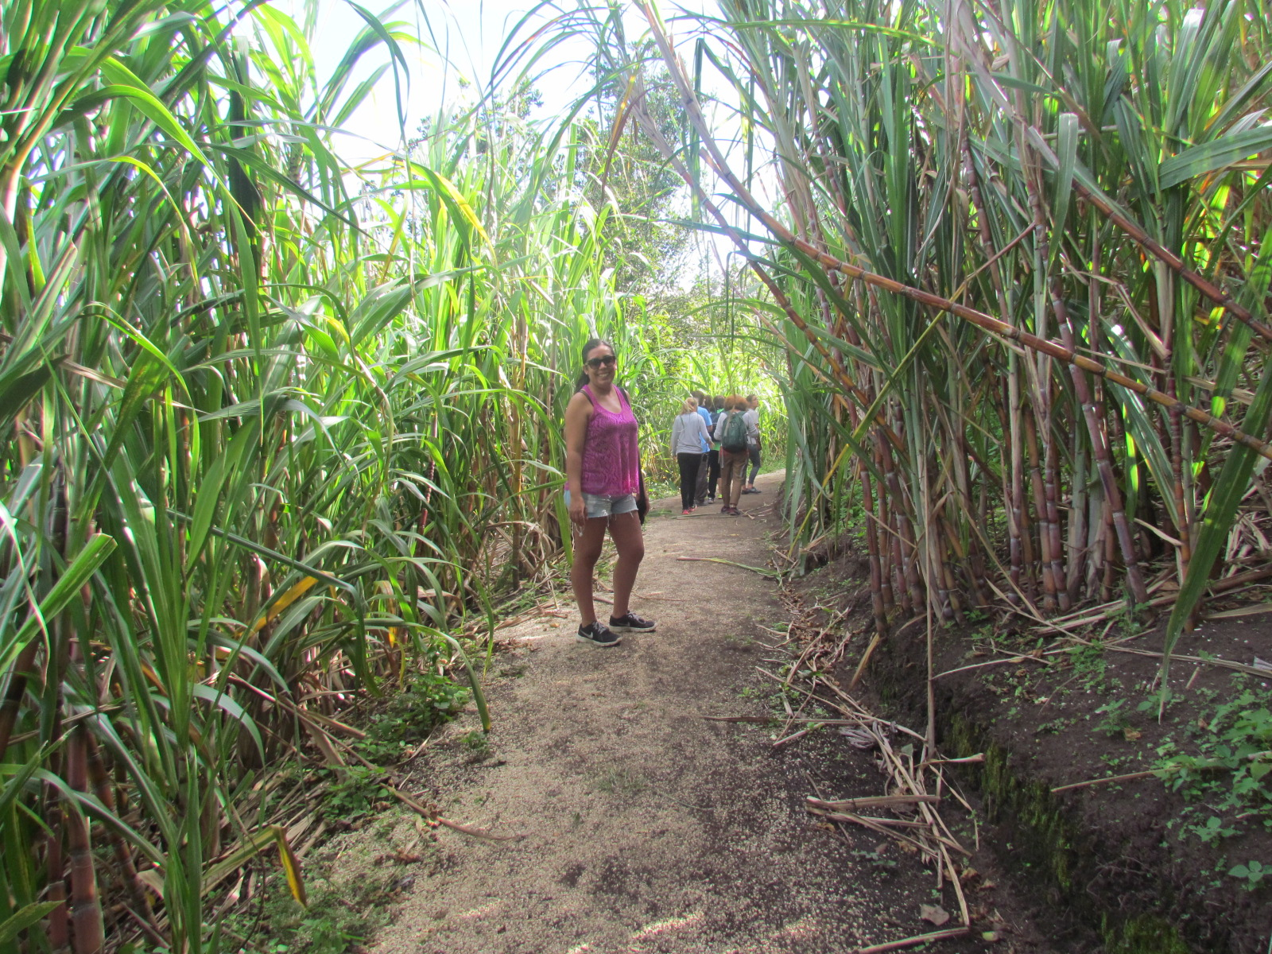
Notes:
They described the different ways in which sugar cane was used.

Slide 43
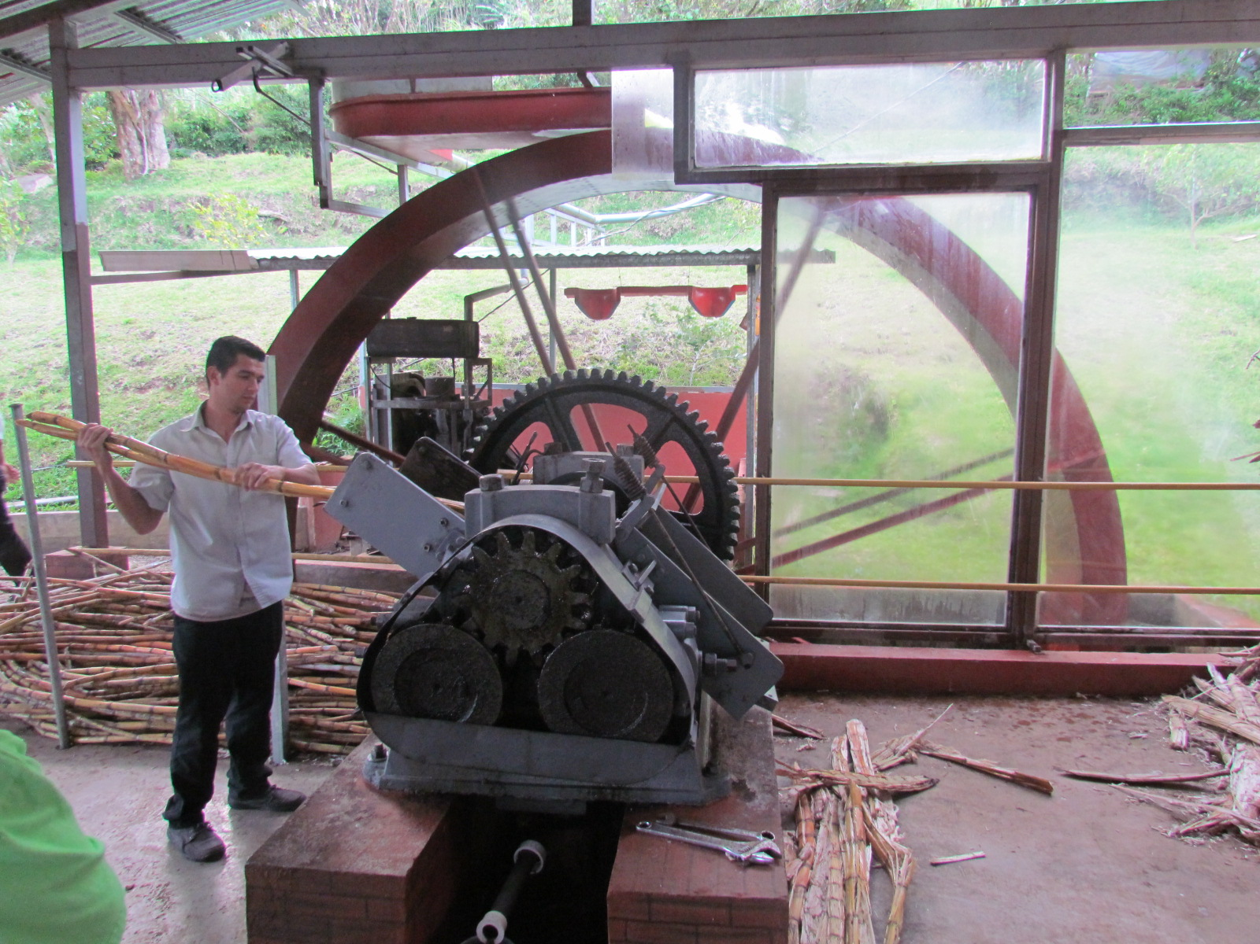

Slide 44
Nature
Notes:
What I enjoyed most about Costa Rica, was nature.

Slide 45
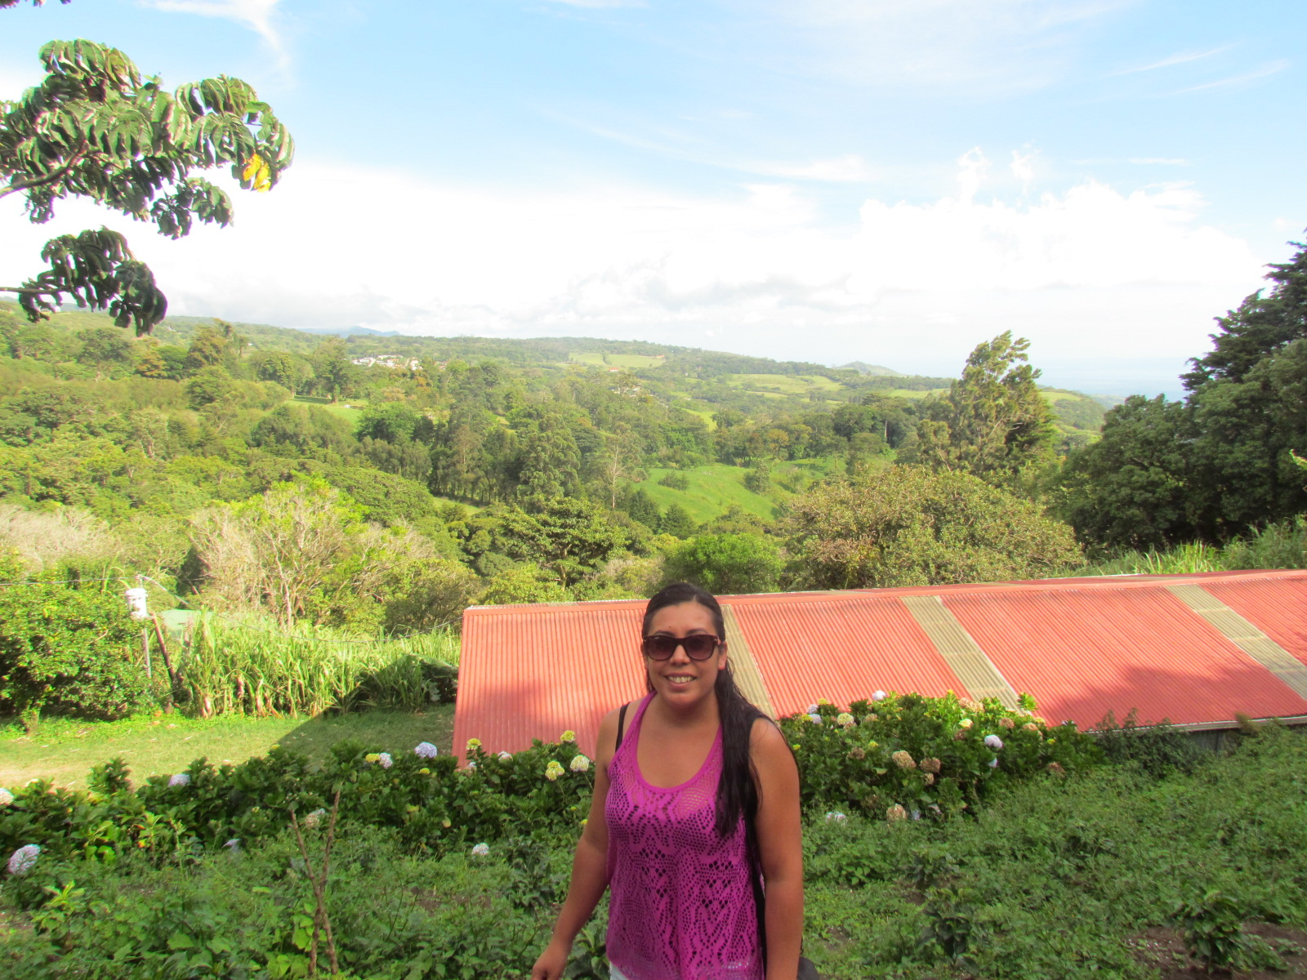
Notes:
There were amazing views everywhere we went, especially in Monteverde and La Fortuna.

Slide 46
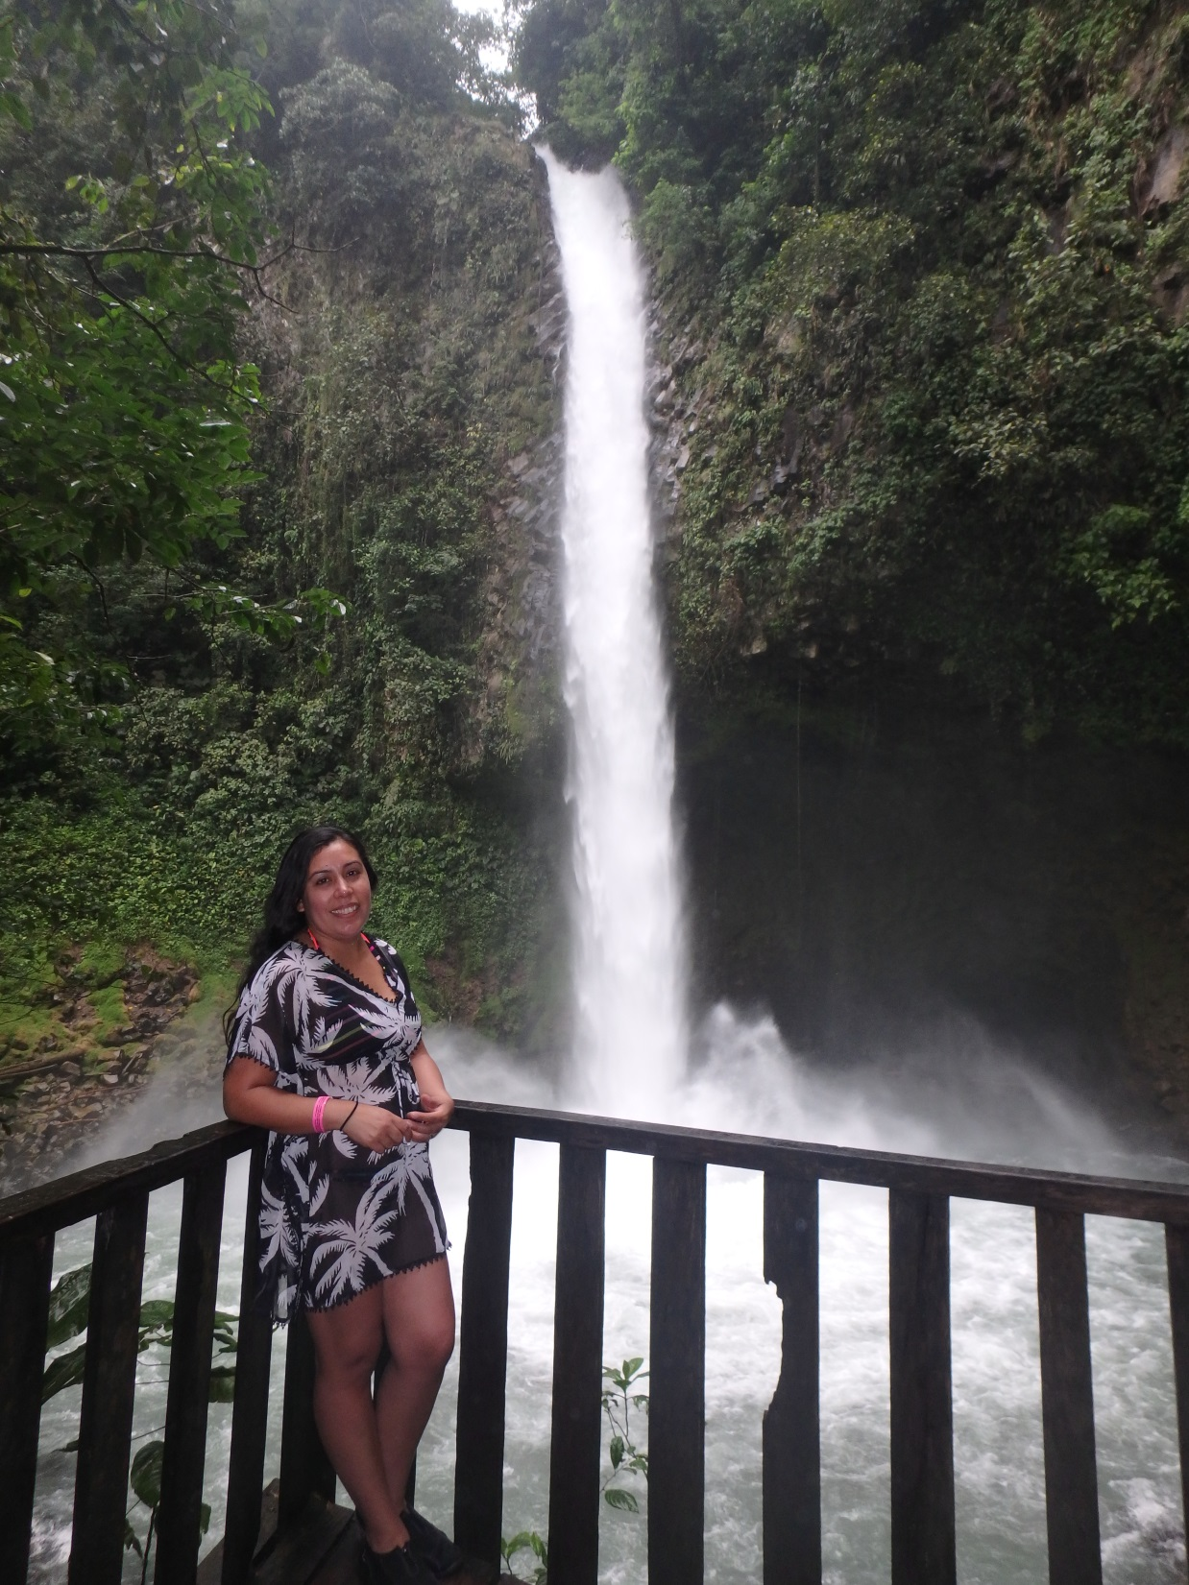
Notes:
This is the waterfall in La Fortuna.

Slide 47
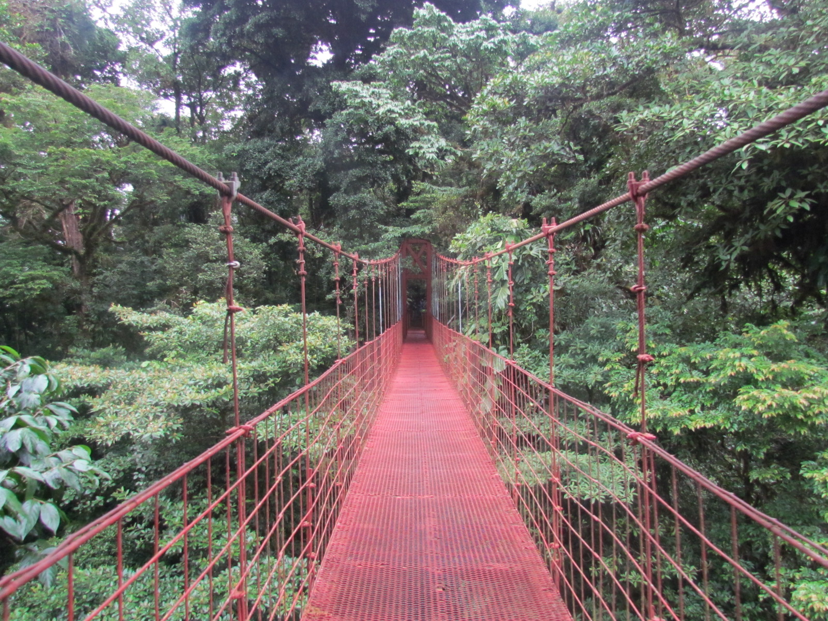
Notes:
A hanging bride in the rainforest during our day hike.

Slide 48
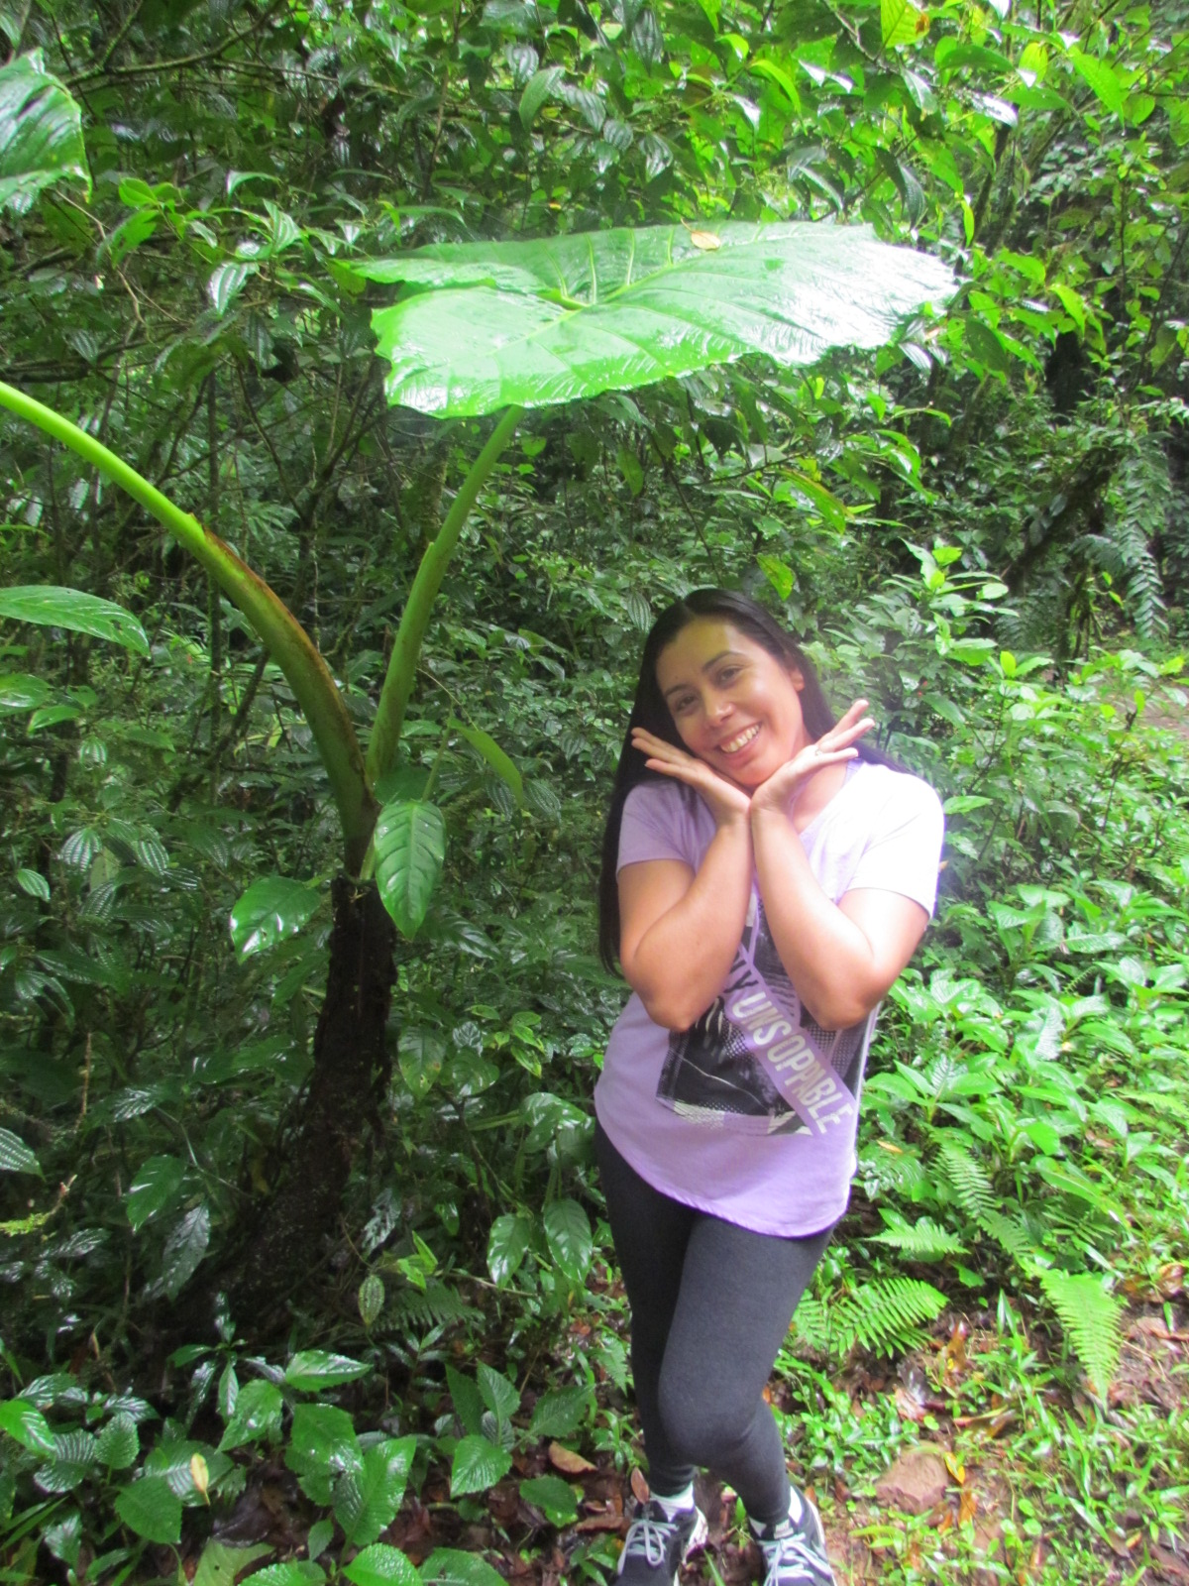
Notes:
We saw lots of interesting plants during our hikes.

Slide 49
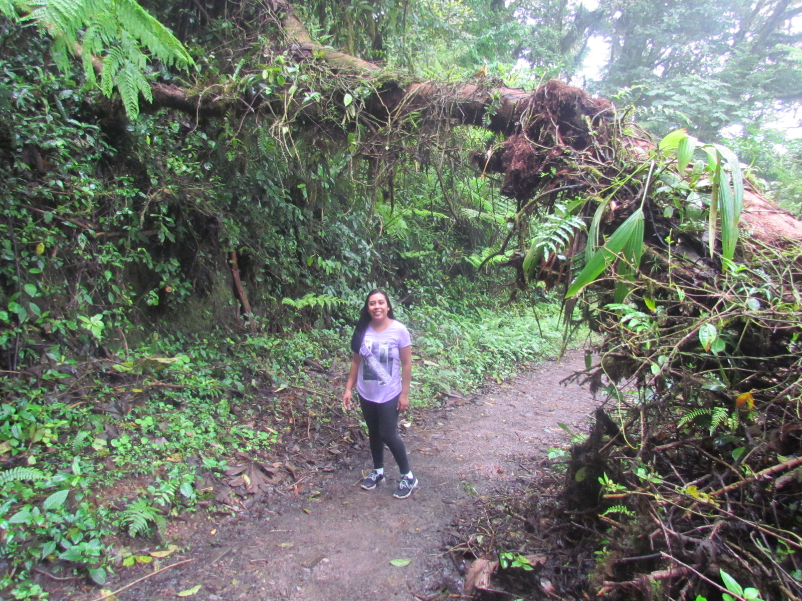

Slide 50
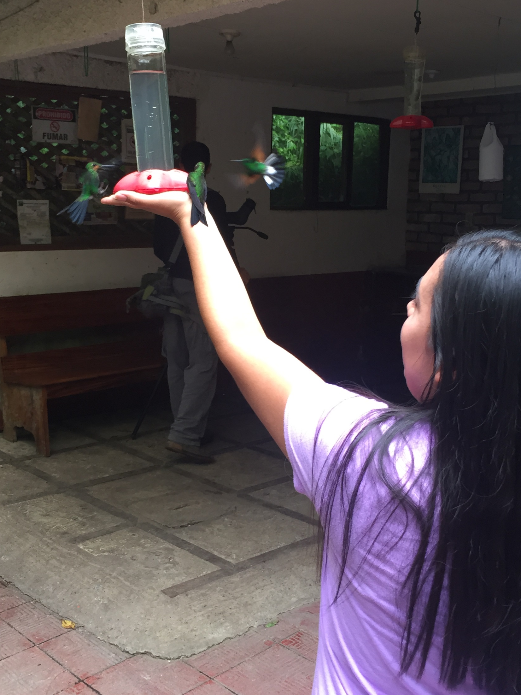
Notes:
We also saw lots of wildlife on our hikes in the rainforest, such as birds…

Slide 51
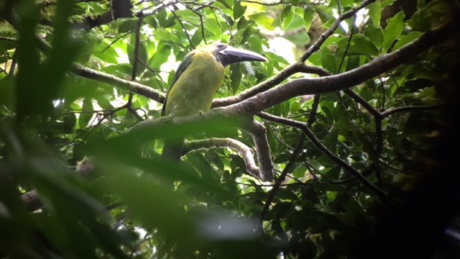

Slide 52
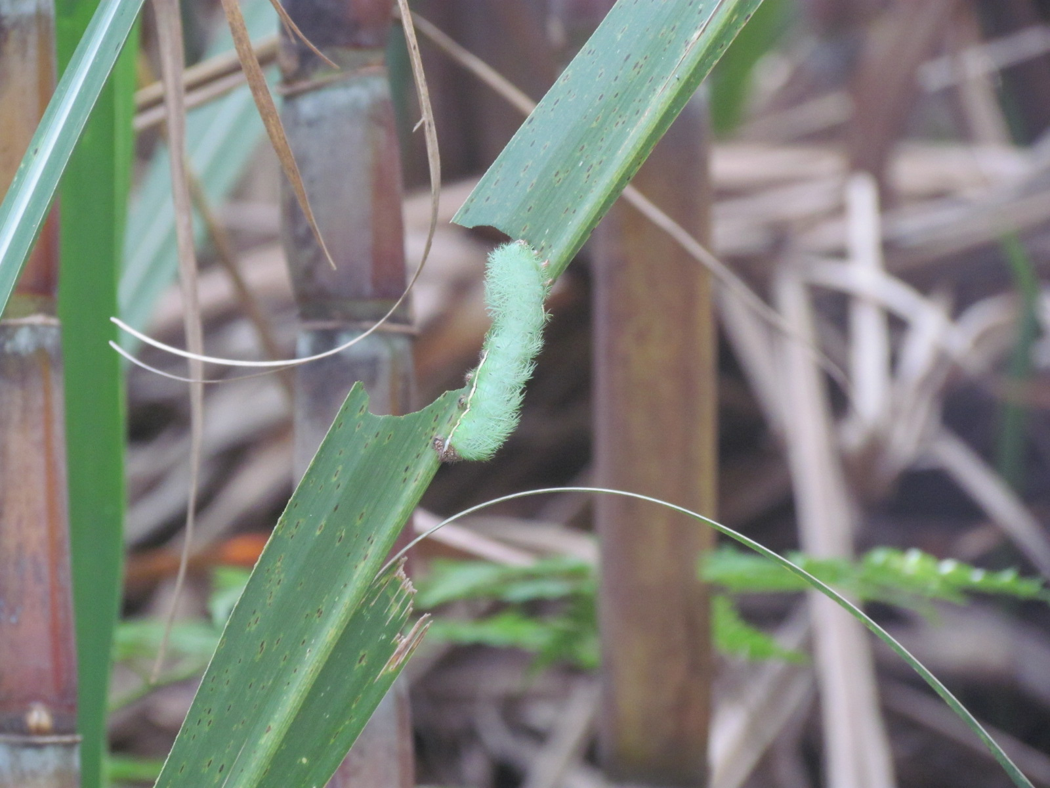
Notes:
Insects…

Slide 53
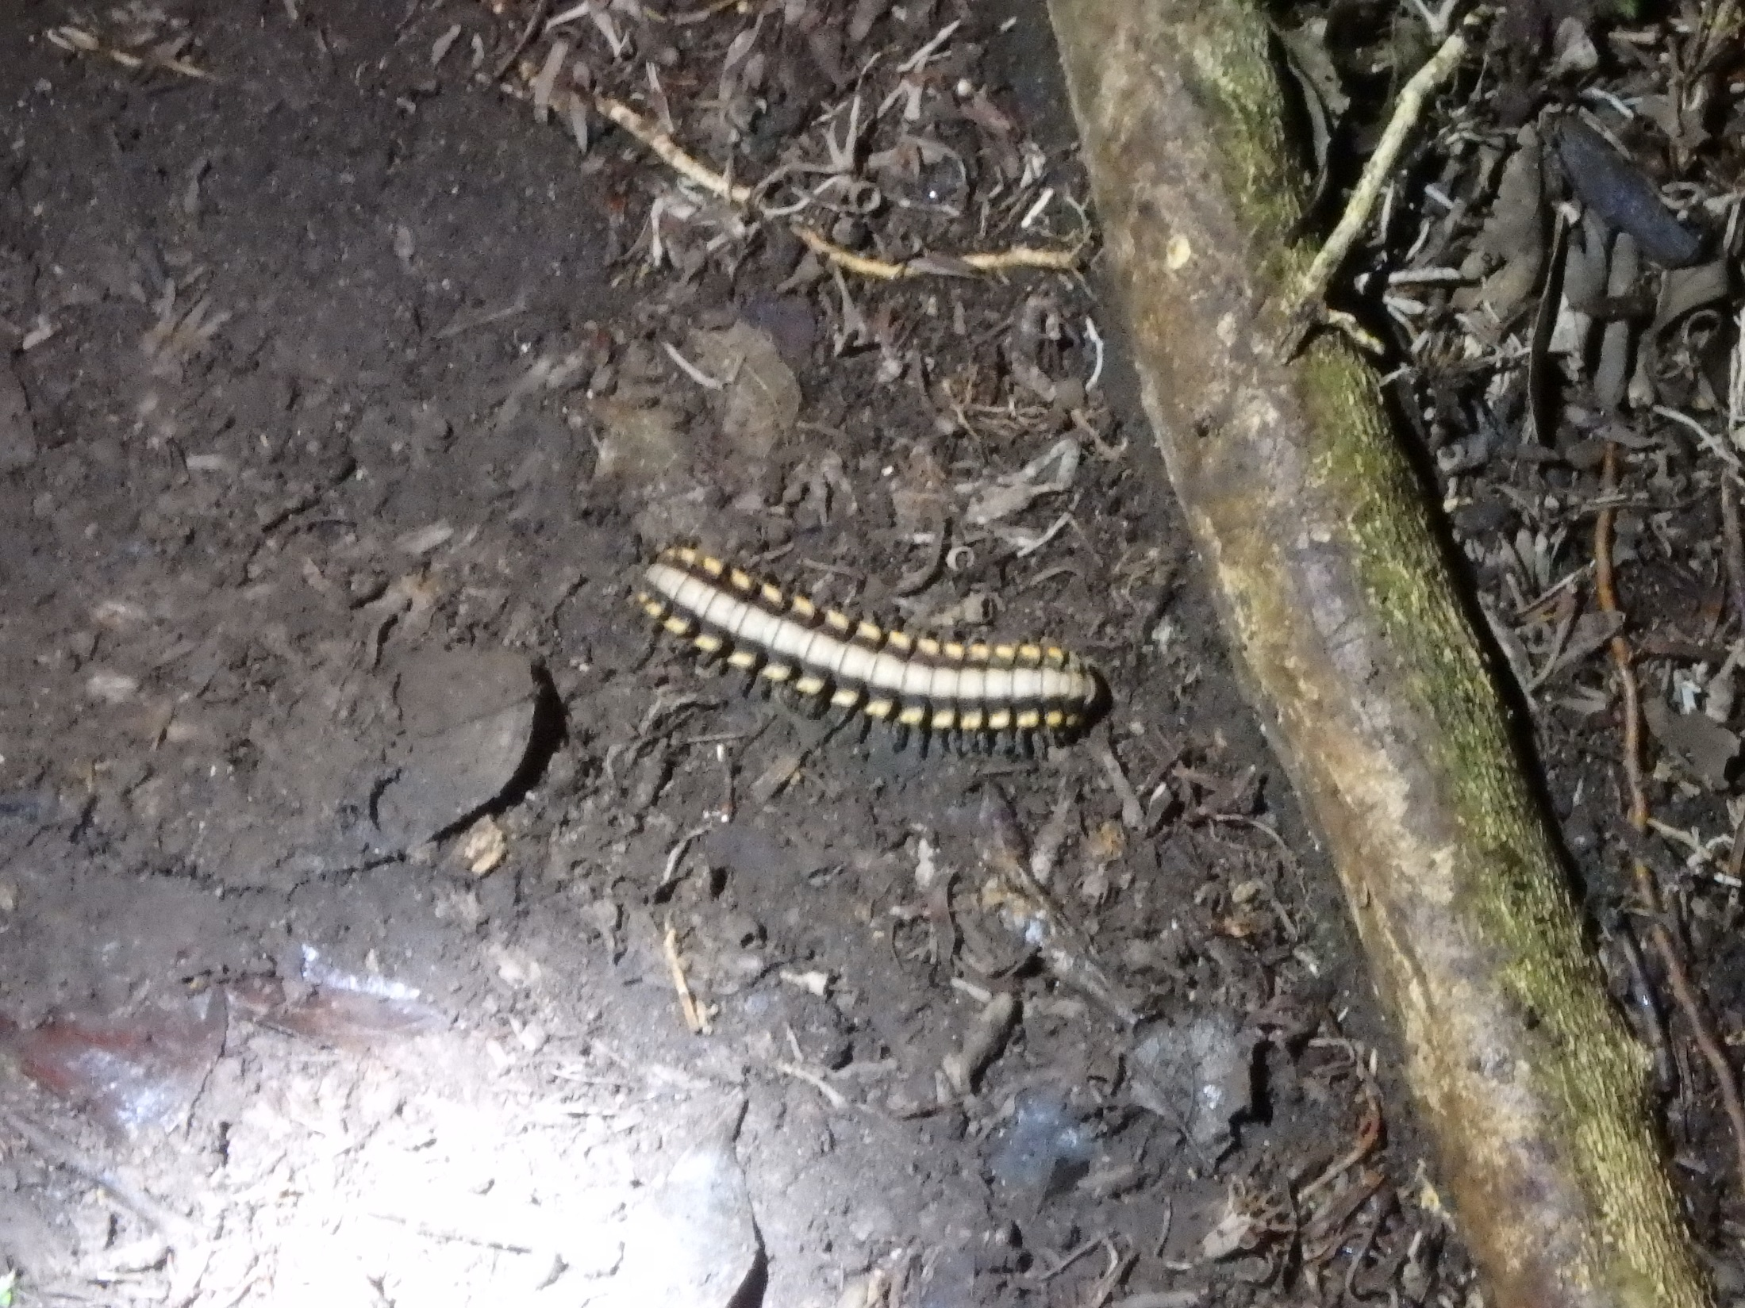

Slide 54
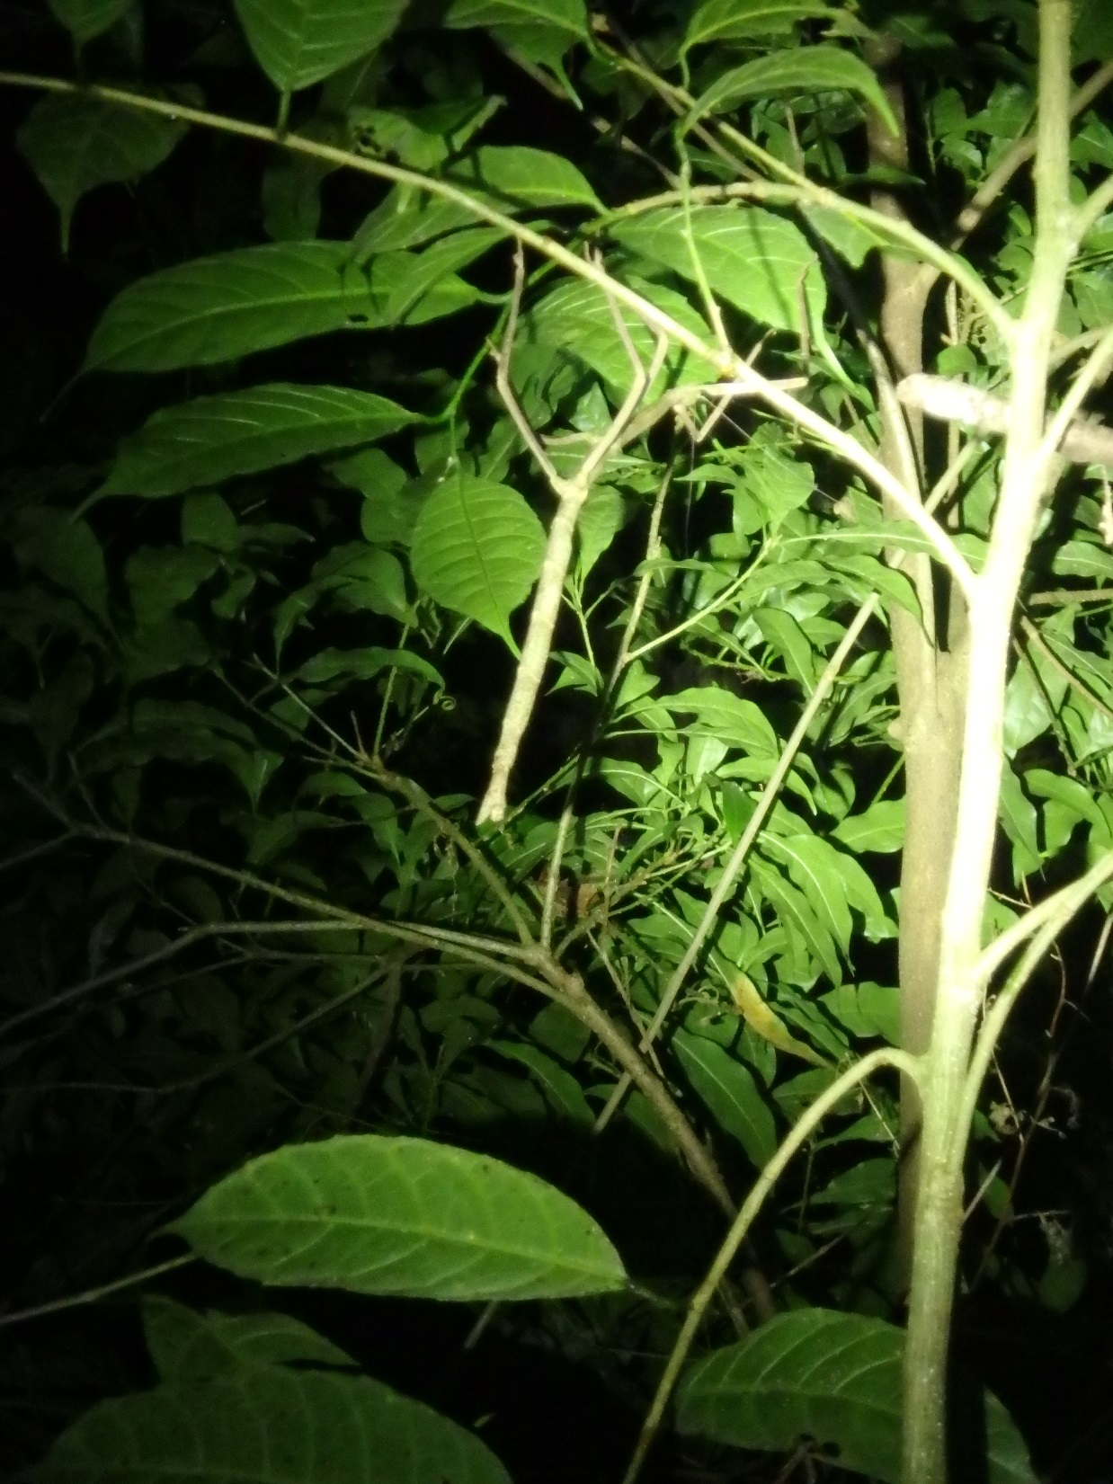

Slide 55
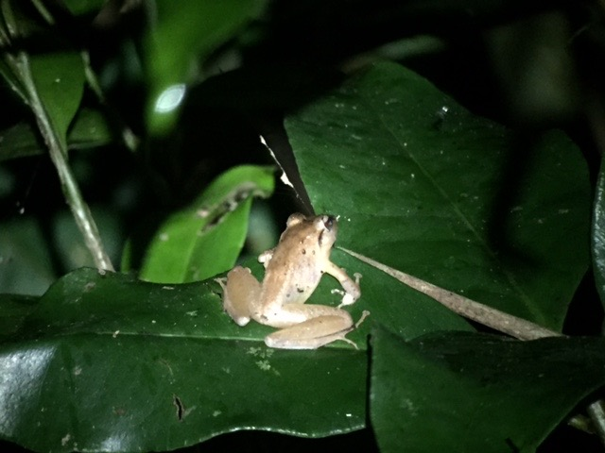
Notes:
Amphibians…

Slide 56
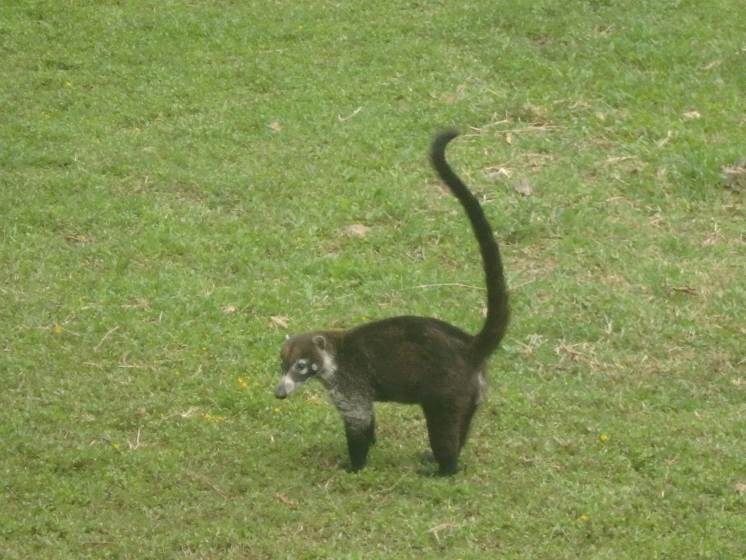
Notes:
And even a few that I had never seen before!

Slide 57
Adventure
Notes:
This would not have been a trip without a little adventure!

Slide 58
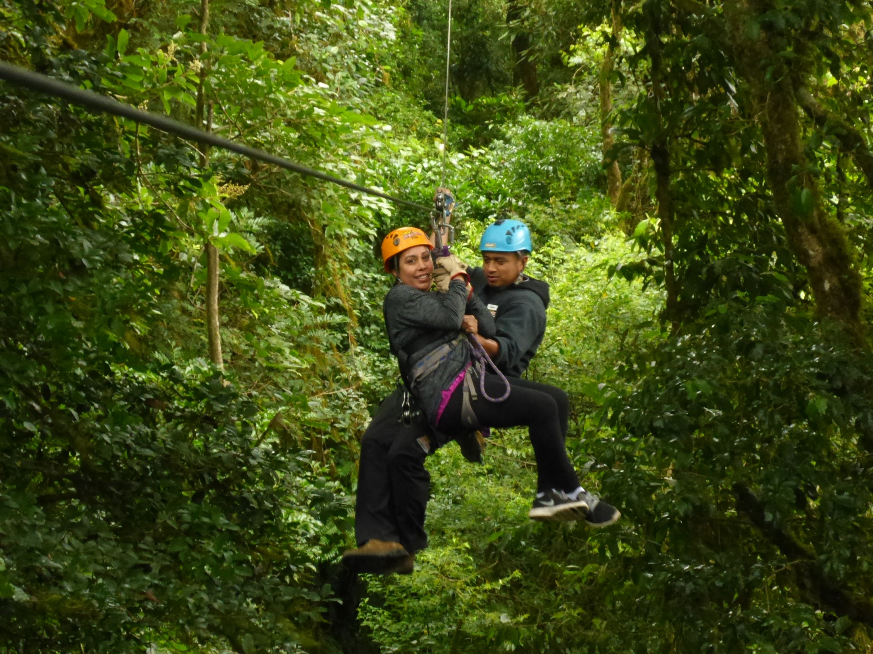
Notes:
I zip-lined for the first time…

Slide 59
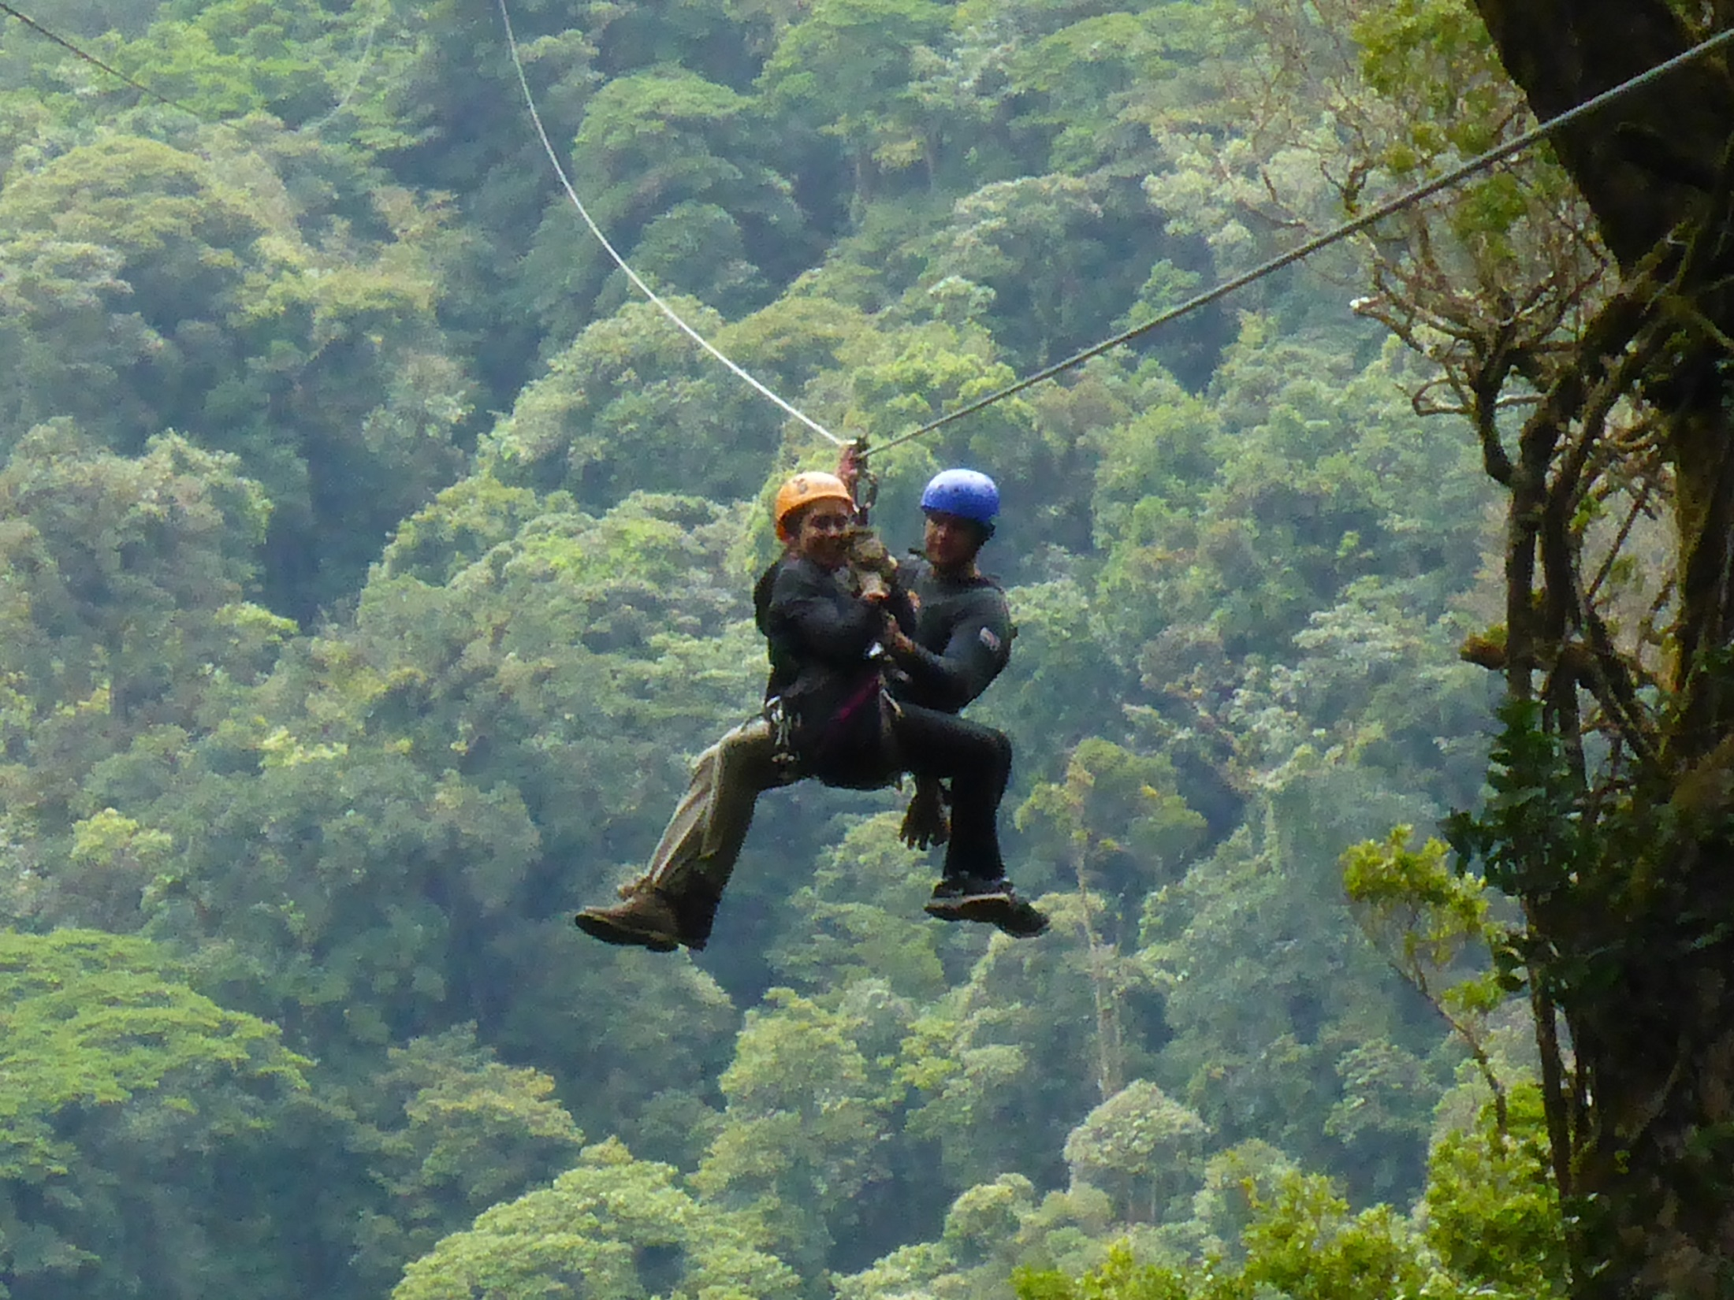

Slide 60
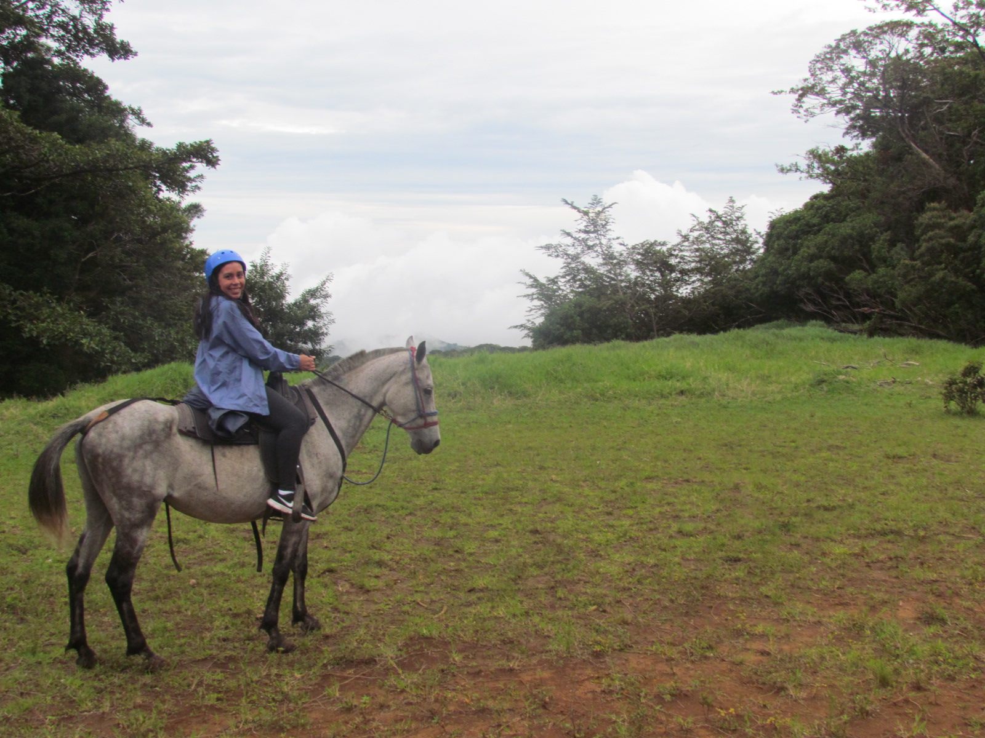
Notes:
Went horseback riding in the rainforest…

Slide 61
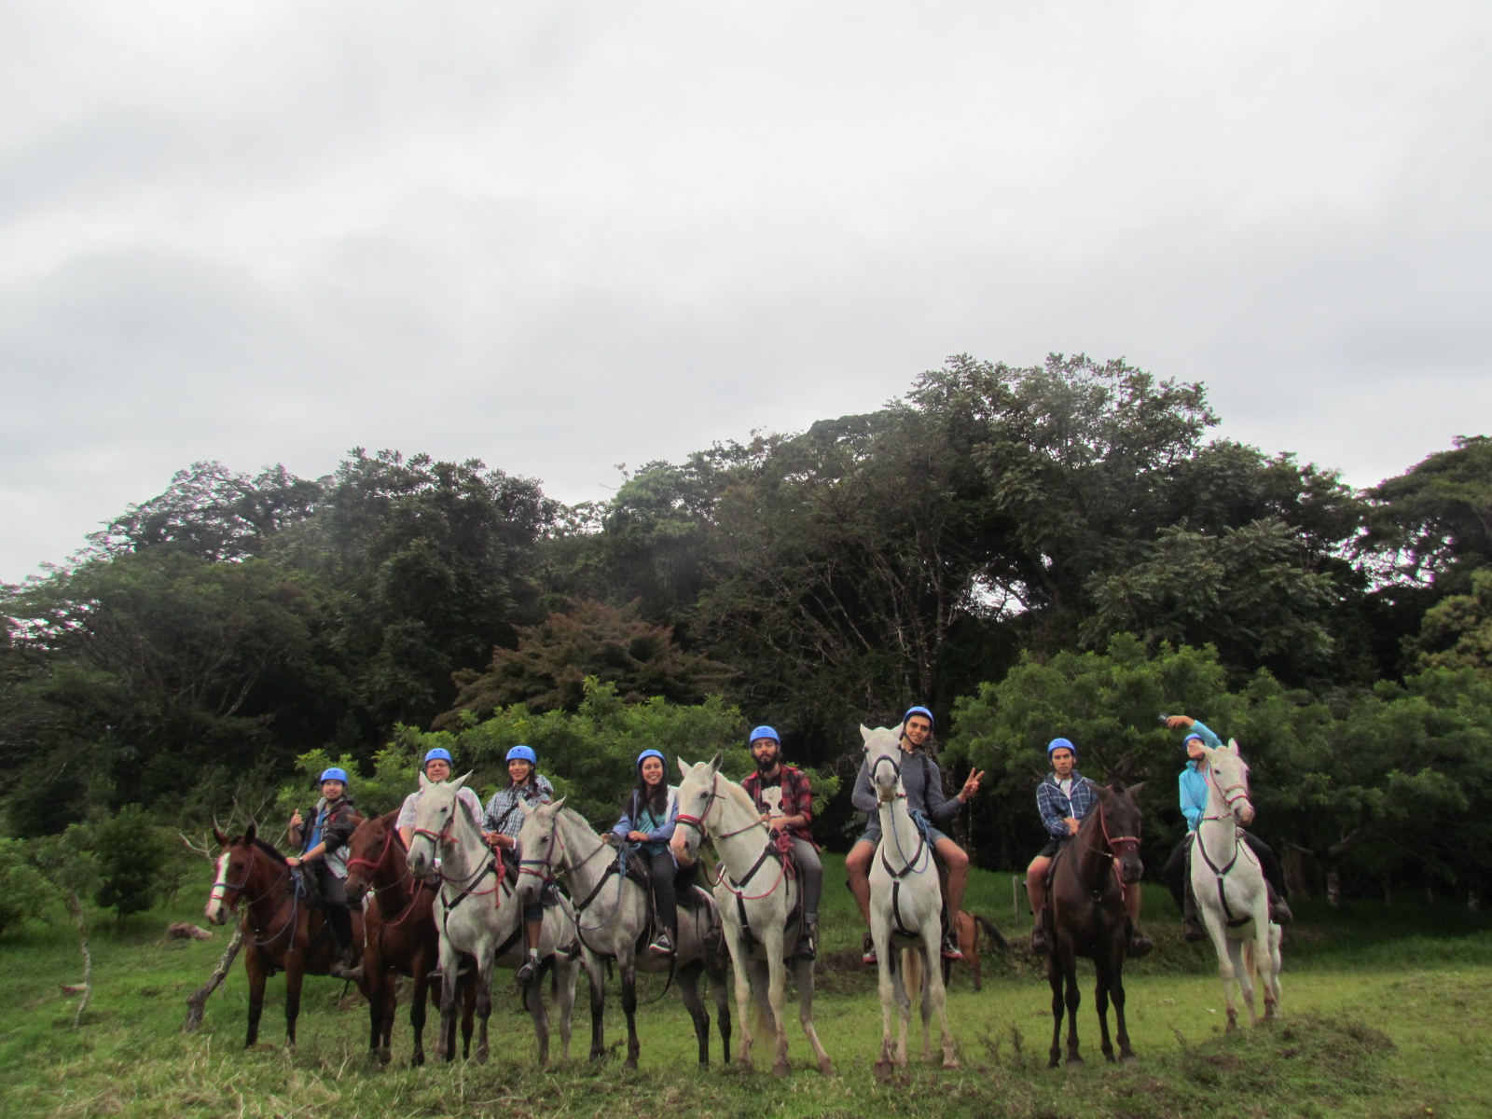

Slide 62
Notes:
And went white water rafting for the first time!

Slide 64
Notes:
Thank you Dr. Adams and all my fellow classmates for an amazing experience!

